Slide 1
Matrix Multiplication Optimization
Using Numba and Triton
Github Link: https://github.com/laiy24/matmul_numba_triton
Yuying Lai

Slide 2
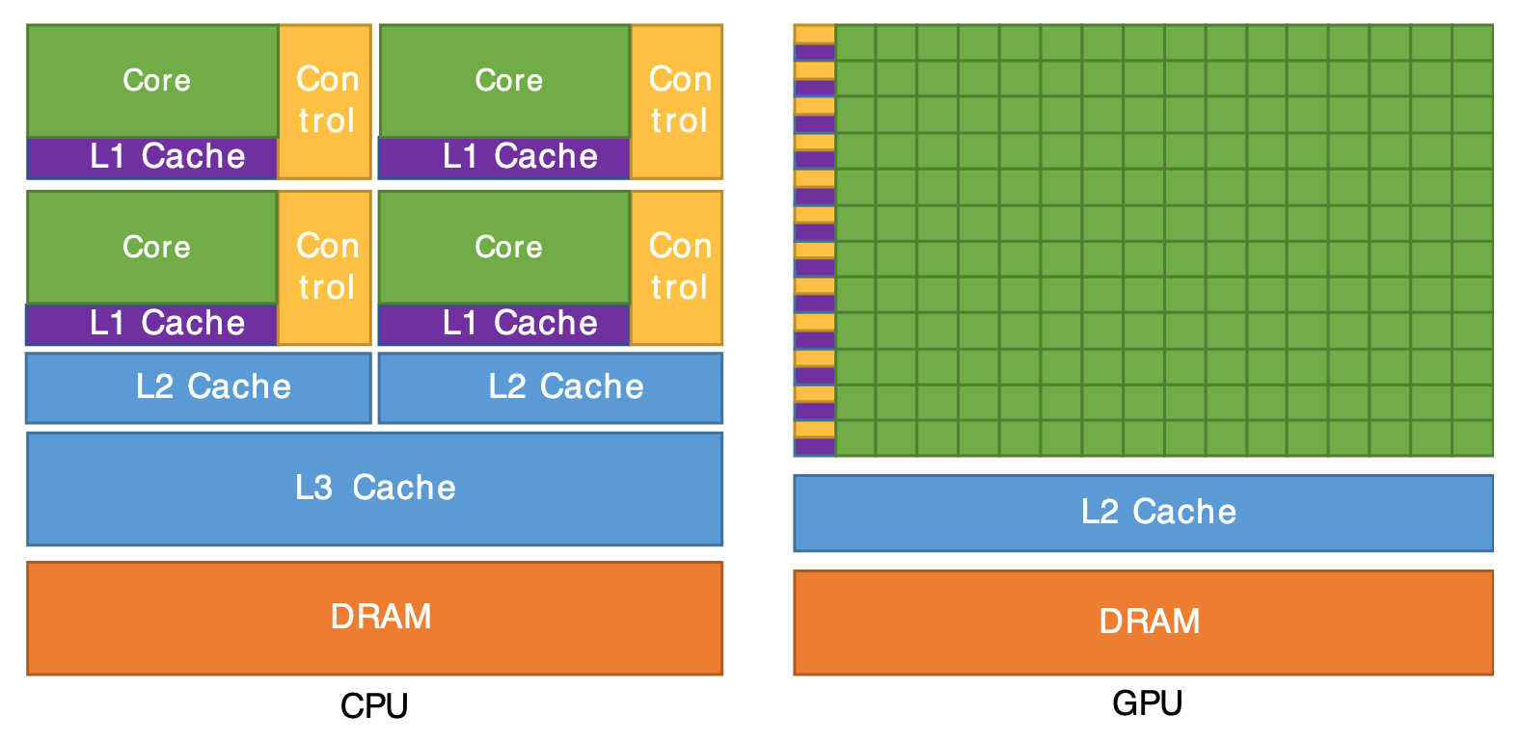
MatMul: Why Slow
Latency in IA-32 Processor :
L1: 4 cycles
L2: 12 cycles
L3/LLC: 44 cycles
DRAM (DDR4) Latency:
50 ns
CPU: 3.5 GHz
3.5 * 50 = 175 cycles
lscpu (i7-11700)
L1d: 384KiB (8 instances)
L1i: 258KiB (8 instances)
L2: 4MiB (8 instances)
L3: 16MiB (1 instance)
https://cvw.cac.cornell.edu/gpu-architecture/gpu-characteristics/design
Intel, “Intel® 64 and ia-32 architectures optimization reference manual,” 2017.
JEDEC Solid State Technology Association, DDR4 SDRAM Standard, JESD79-4C, Revision of JESD79-4B, Jan. 2020.
[Online]. Available: https://www.jedec.org/standards-documents

Slide 3
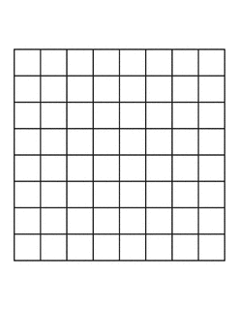
Spatial Locality
Assume a cache line hold 4 elements of this 8x8 matrix
(0,0) - L3 Cache Miss
Latency = L1 + L2 + L3 + DRAM
(0,1:3) – L1 Cache Hit
Latency = L1
(0,4) – L3 Cache Miss
Latency = L1 + L2 + L3 + DRAM
…
(0,0) - L3 Cache Miss
Latency = L1 + L2 + L3 + DRAM
(1,0) - L3 Cache Miss
Latency = L1 + L2 + L3 + DRAM
(2,0) - L3 Cache Miss
Latency = L1 + L2 + L3 + DRAM
…

Slide 4
Temporal Locality
Assume a cache line hold 4 elements of this 8x8 matrix
Assume there are only 4 cache lines in L1
Processing row 0:1
L1 caches:
(0,0:3)
(0,4:7)
(1,0:3)
(1,4:7)
Processing row 2:3
L1 caches:
(2,0:3)
(2,4:7)
(3,0:3)
(3,4:7)
What if we want to reuse (0,0) again?
Miss !

Slide 5
1. Rearrange Memory Layout
Assume a cache line hold 4 elements of this 8x8 matrix
Accessing B
(0,0) - L3 Cache Miss
Latency = L1 + L2 + L3 + DRAM
(1,0) - L3 Cache Miss
Latency = L1 + L2 + L3 + DRAM
(2,0) - L3 Cache Miss
Latency = L1 + L2 + L3 + DRAM
Accessing B^T (transpose)
(0,0) - L3 Cache Miss
Latency = L1 + L2 + L3 + DRAM
(0,1:3) – L1 Cache Hit
Latency = L1
(0,4) – L3 Cache Miss
Latency = L1 + L2 + L3 + DRAM
Be careful!
Transforming B to B^T takes times.
Only benefit if B is reused.
C = A * B
for i in range(N):
for j in range(N):
for k in range(N):
C[i, j] += A[i, k] * B[k, j]

Slide 6
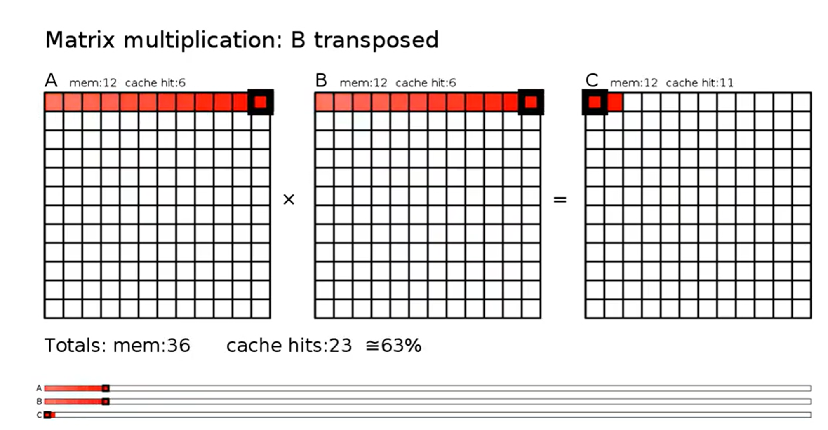
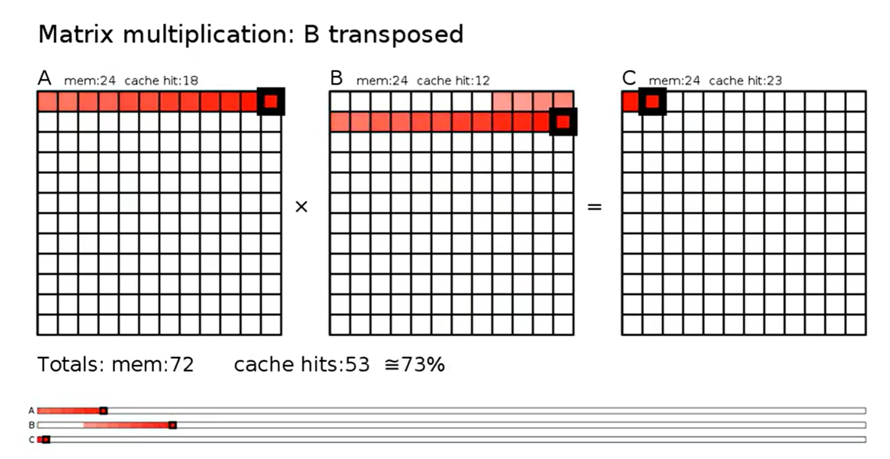
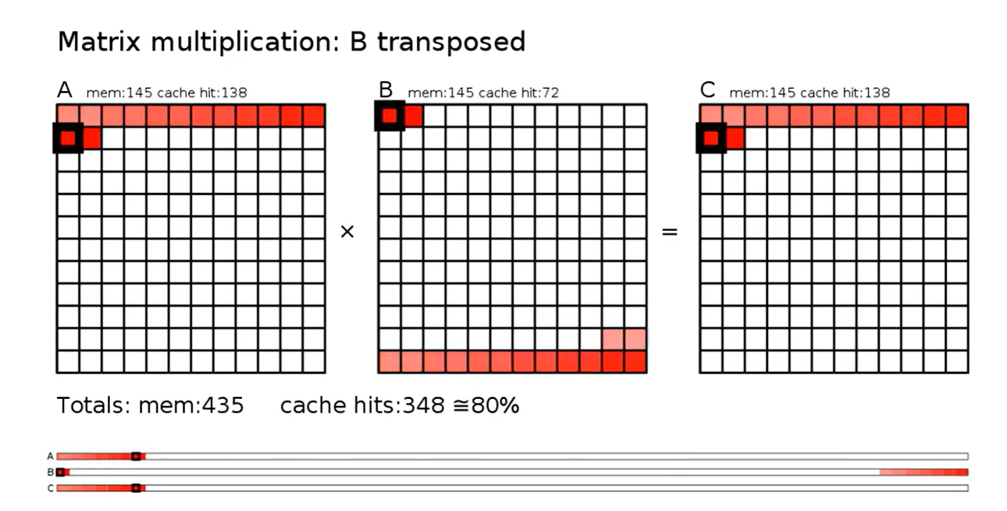
2. Loop tiling (Blocking) - Problem
Assume:
Each matrix has its own L1 L2 cache
Cache lines: 2 data items/cache line L1: 2 cache lines/instance
L2: 8 cache lines/instance
C[i,k] += A[i, k] * B[k, j]
Total Memory Request: A: 12 * 12 * 12 = 1728 read , 72 L2 miss , 4.1% miss rate
B: 12 * 12 * 12 = 1728 read , 864 L2 miss, 50% miss rate
C: 12 * 12 * 12 = 1728 read, 72 L2 miss, 4.1% miss rate
Total L2 miss rate = 19.44%
wentasah/mmul-anim: Visualization of cache-optimized matrix multiplication
M. S. Lam, E. E. Rothberg, and M. E. Wolf, “The cache performance and optimizations of blocked algorithms,” SIGPLAN Notices, vol. 26, no. 4, pp. 63–74, Apr. 1991, doi: 10.1145/125712.125719.

Slide 7
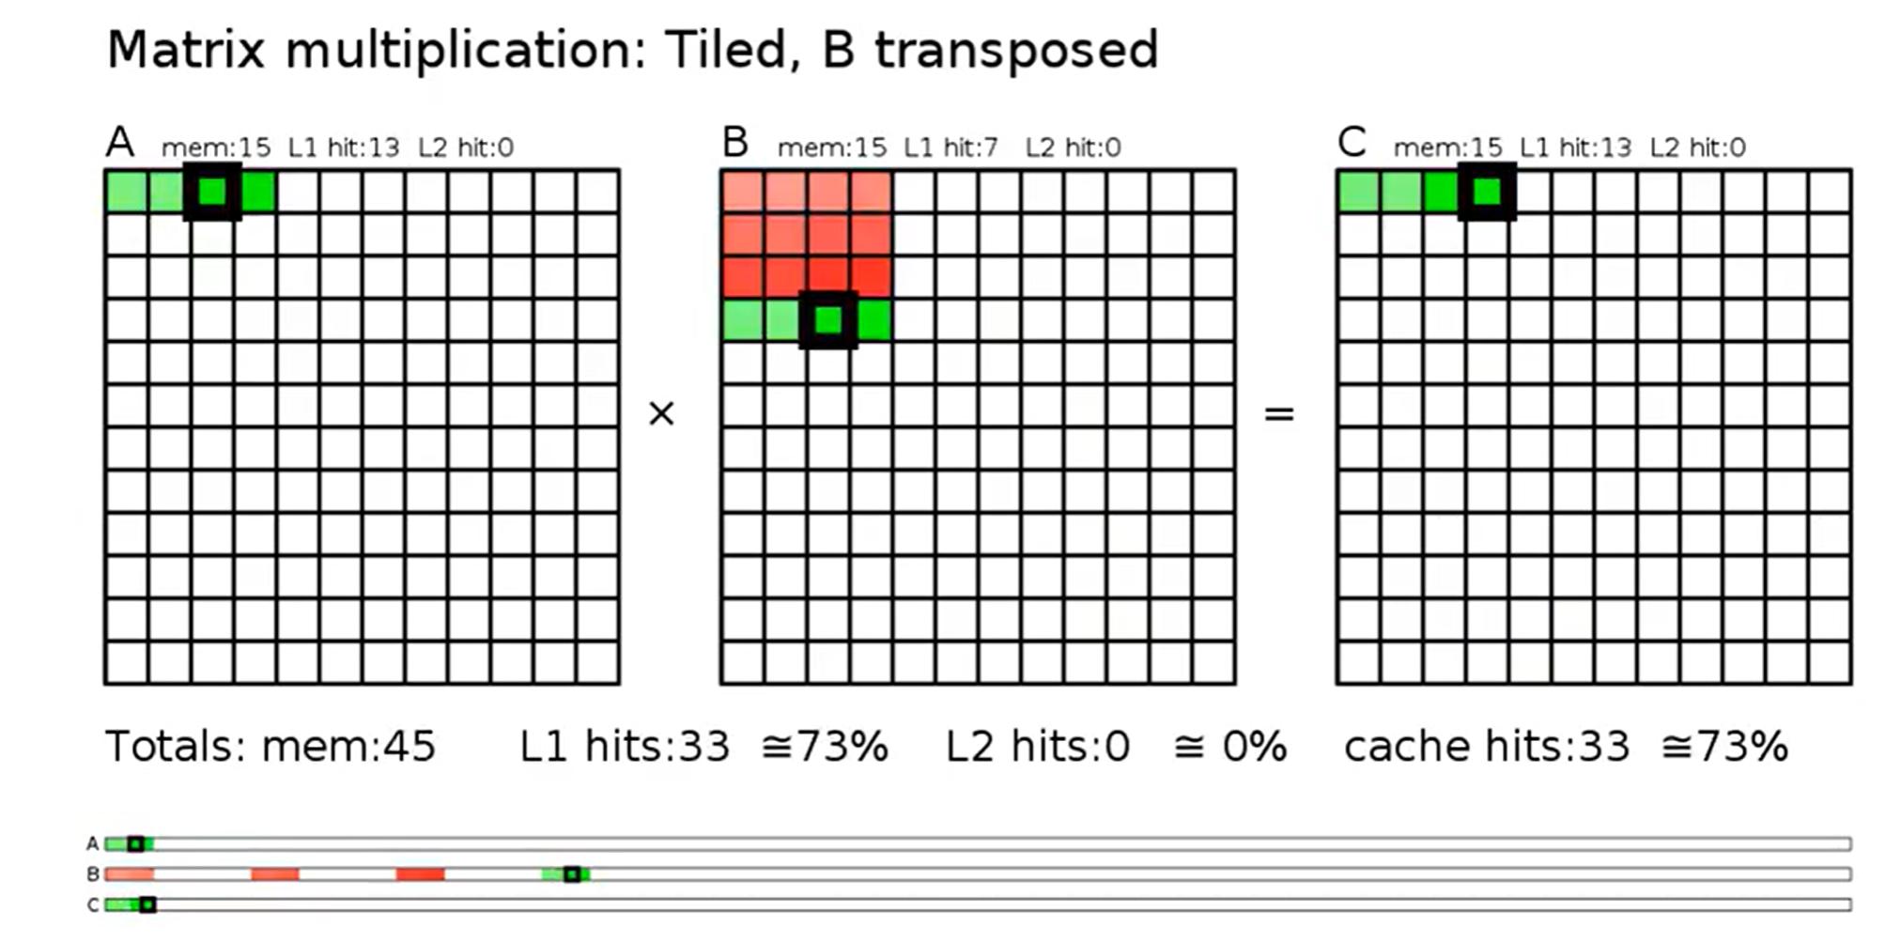
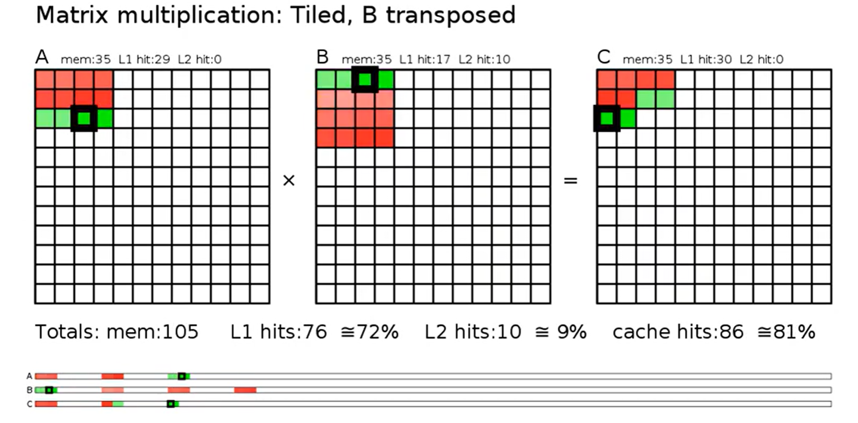
2. Loop tiling (Blocking) - Implementation
for ii in range(0, N, B1):
for jj in range(0, N, B1):
for kk in range(0, N, B1):
for i in range(ii, min(ii + B1, N)):
for j in range(jj, min(jj + B1, N)):
for k in range(kk, min(kk + B1, N)):
C[i,j] += A[i, k] * B[k, j]
Total Memory Request: A: 1728 read , 216 L2 miss , 12.5% miss rate
B: 1728 read , 216 L2 miss, 12.5% miss rate
C: 1728 read, 72 L2 miss, 4.1% miss rate
Total L2 miss rate: 9.7%
wentasah/mmul-anim: Visualization of cache-optimized matrix multiplication
M. S. Lam, E. E. Rothberg, and M. E. Wolf, “The cache performance and optimizations of blocked algorithms,” SIGPLAN Notices, vol. 26, no. 4, pp. 63–74, Apr. 1991, doi: 10.1145/125712.125719.

Slide 8
2. Loop tiling (Blocking) - Limitation
All matrixes share the same core – sharing L1 L2 L3 (Happens without blocking too)
Contention: A can evicts B or C, and vise versa.
Loop control branching overhead.
3 loops -> 6 loops
Different hardware product different result at different block size.
Still a lot of miss in L1.
wentasah/mmul-anim: Visualization of cache-optimized matrix multiplication
M. S. Lam, E. E. Rothberg, and M. E. Wolf, “The cache performance and optimizations of blocked algorithms,” SIGPLAN Notices, vol. 26, no. 4, pp. 63–74, Apr. 1991, doi: 10.1145/125712.125719.

Slide 9
2. Loop tiling (Blocking) – 2 Level
for i2 in range(0, N, B1_L2):
for j2 in range(0, N, B1_L2):
for k2 in range(0, N, B1_L2):
for i1 in range(i2, min(i2 + B1_L2, N), B2_L1):
for j1 in range(j2, min(j2 + B1_L2, N), B2_L1):
for k1 in range(k2, min(k2 + B1_L2, N), B2_L1):
for i in range(i1, min(i1 + B2_L1, N)):
for j in range(j1, min(j1 + B2_L1, N)):
for k in range(k1, min(k1 + B2_L1, N)):
C[i, j] += A[i, k] * B[k, j]
wentasah/mmul-anim: Visualization of cache-optimized matrix multiplication
M. S. Lam, E. E. Rothberg, and M. E. Wolf, “The cache performance and optimizations of blocked algorithms,” SIGPLAN Notices, vol. 26, no. 4, pp. 63–74, Apr. 1991, doi: 10.1145/125712.125719.

Slide 10
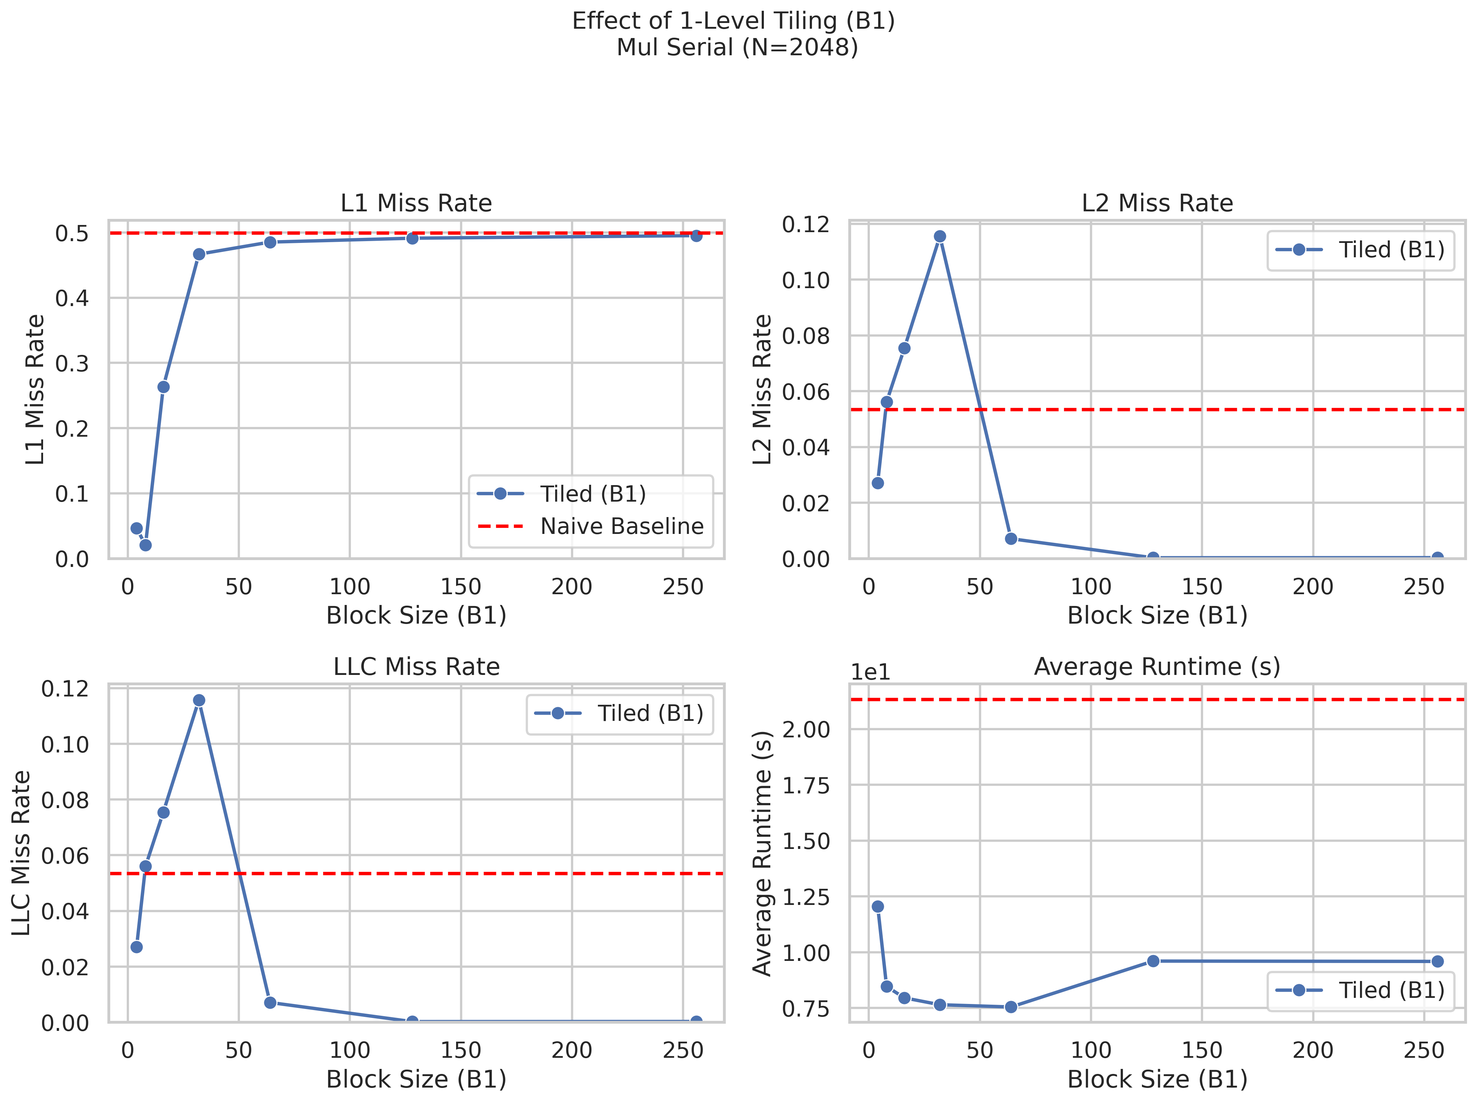
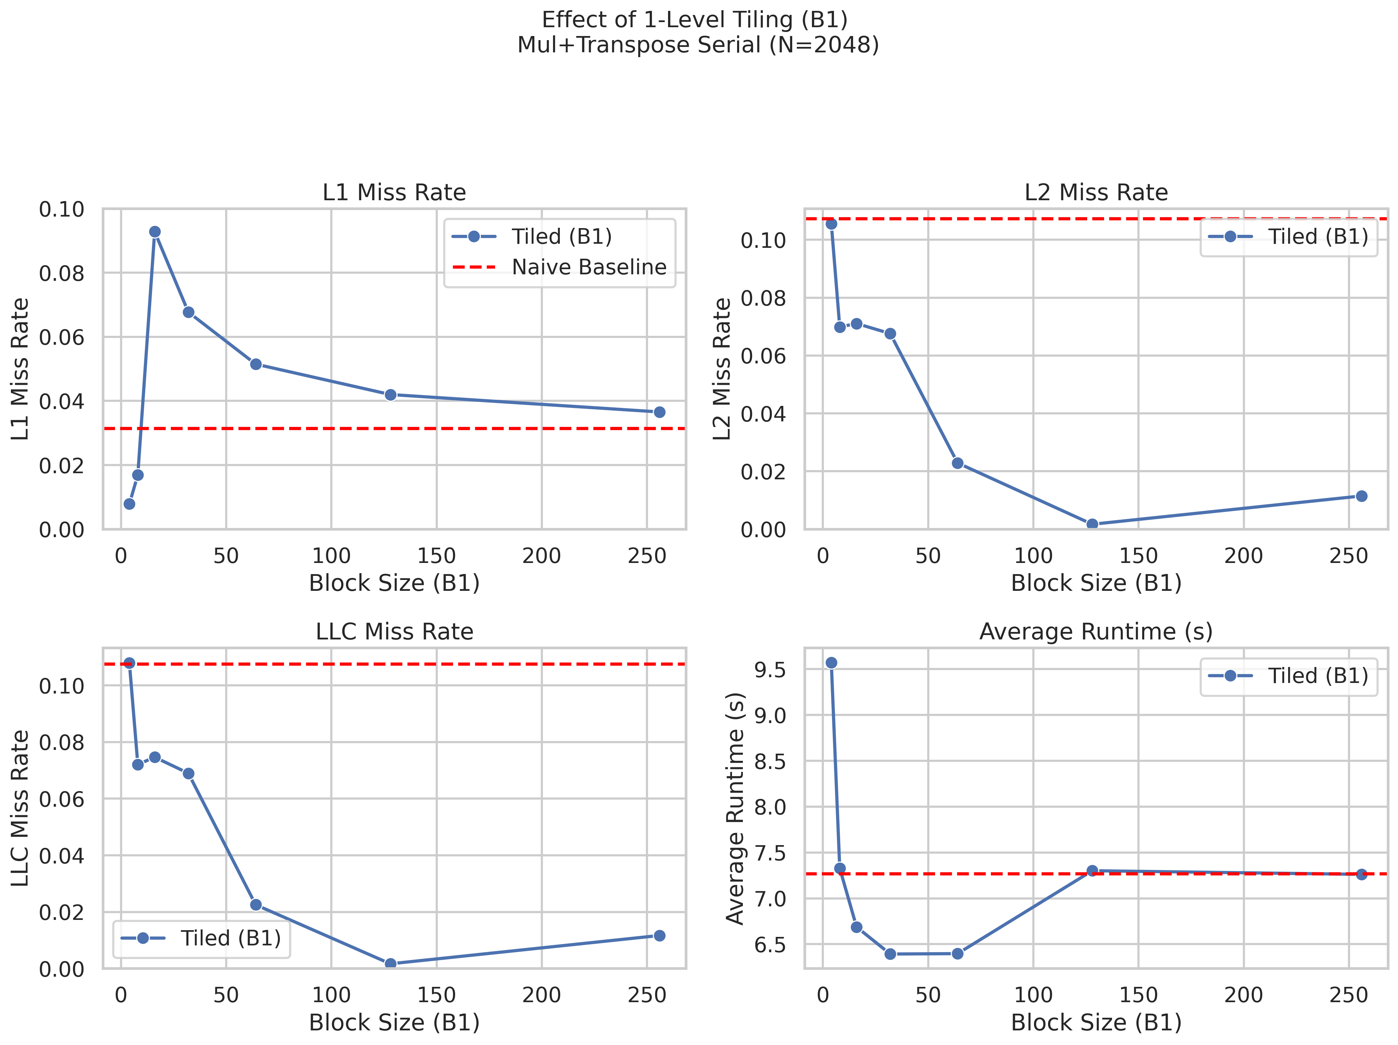
Perf evaluation

Slide 11
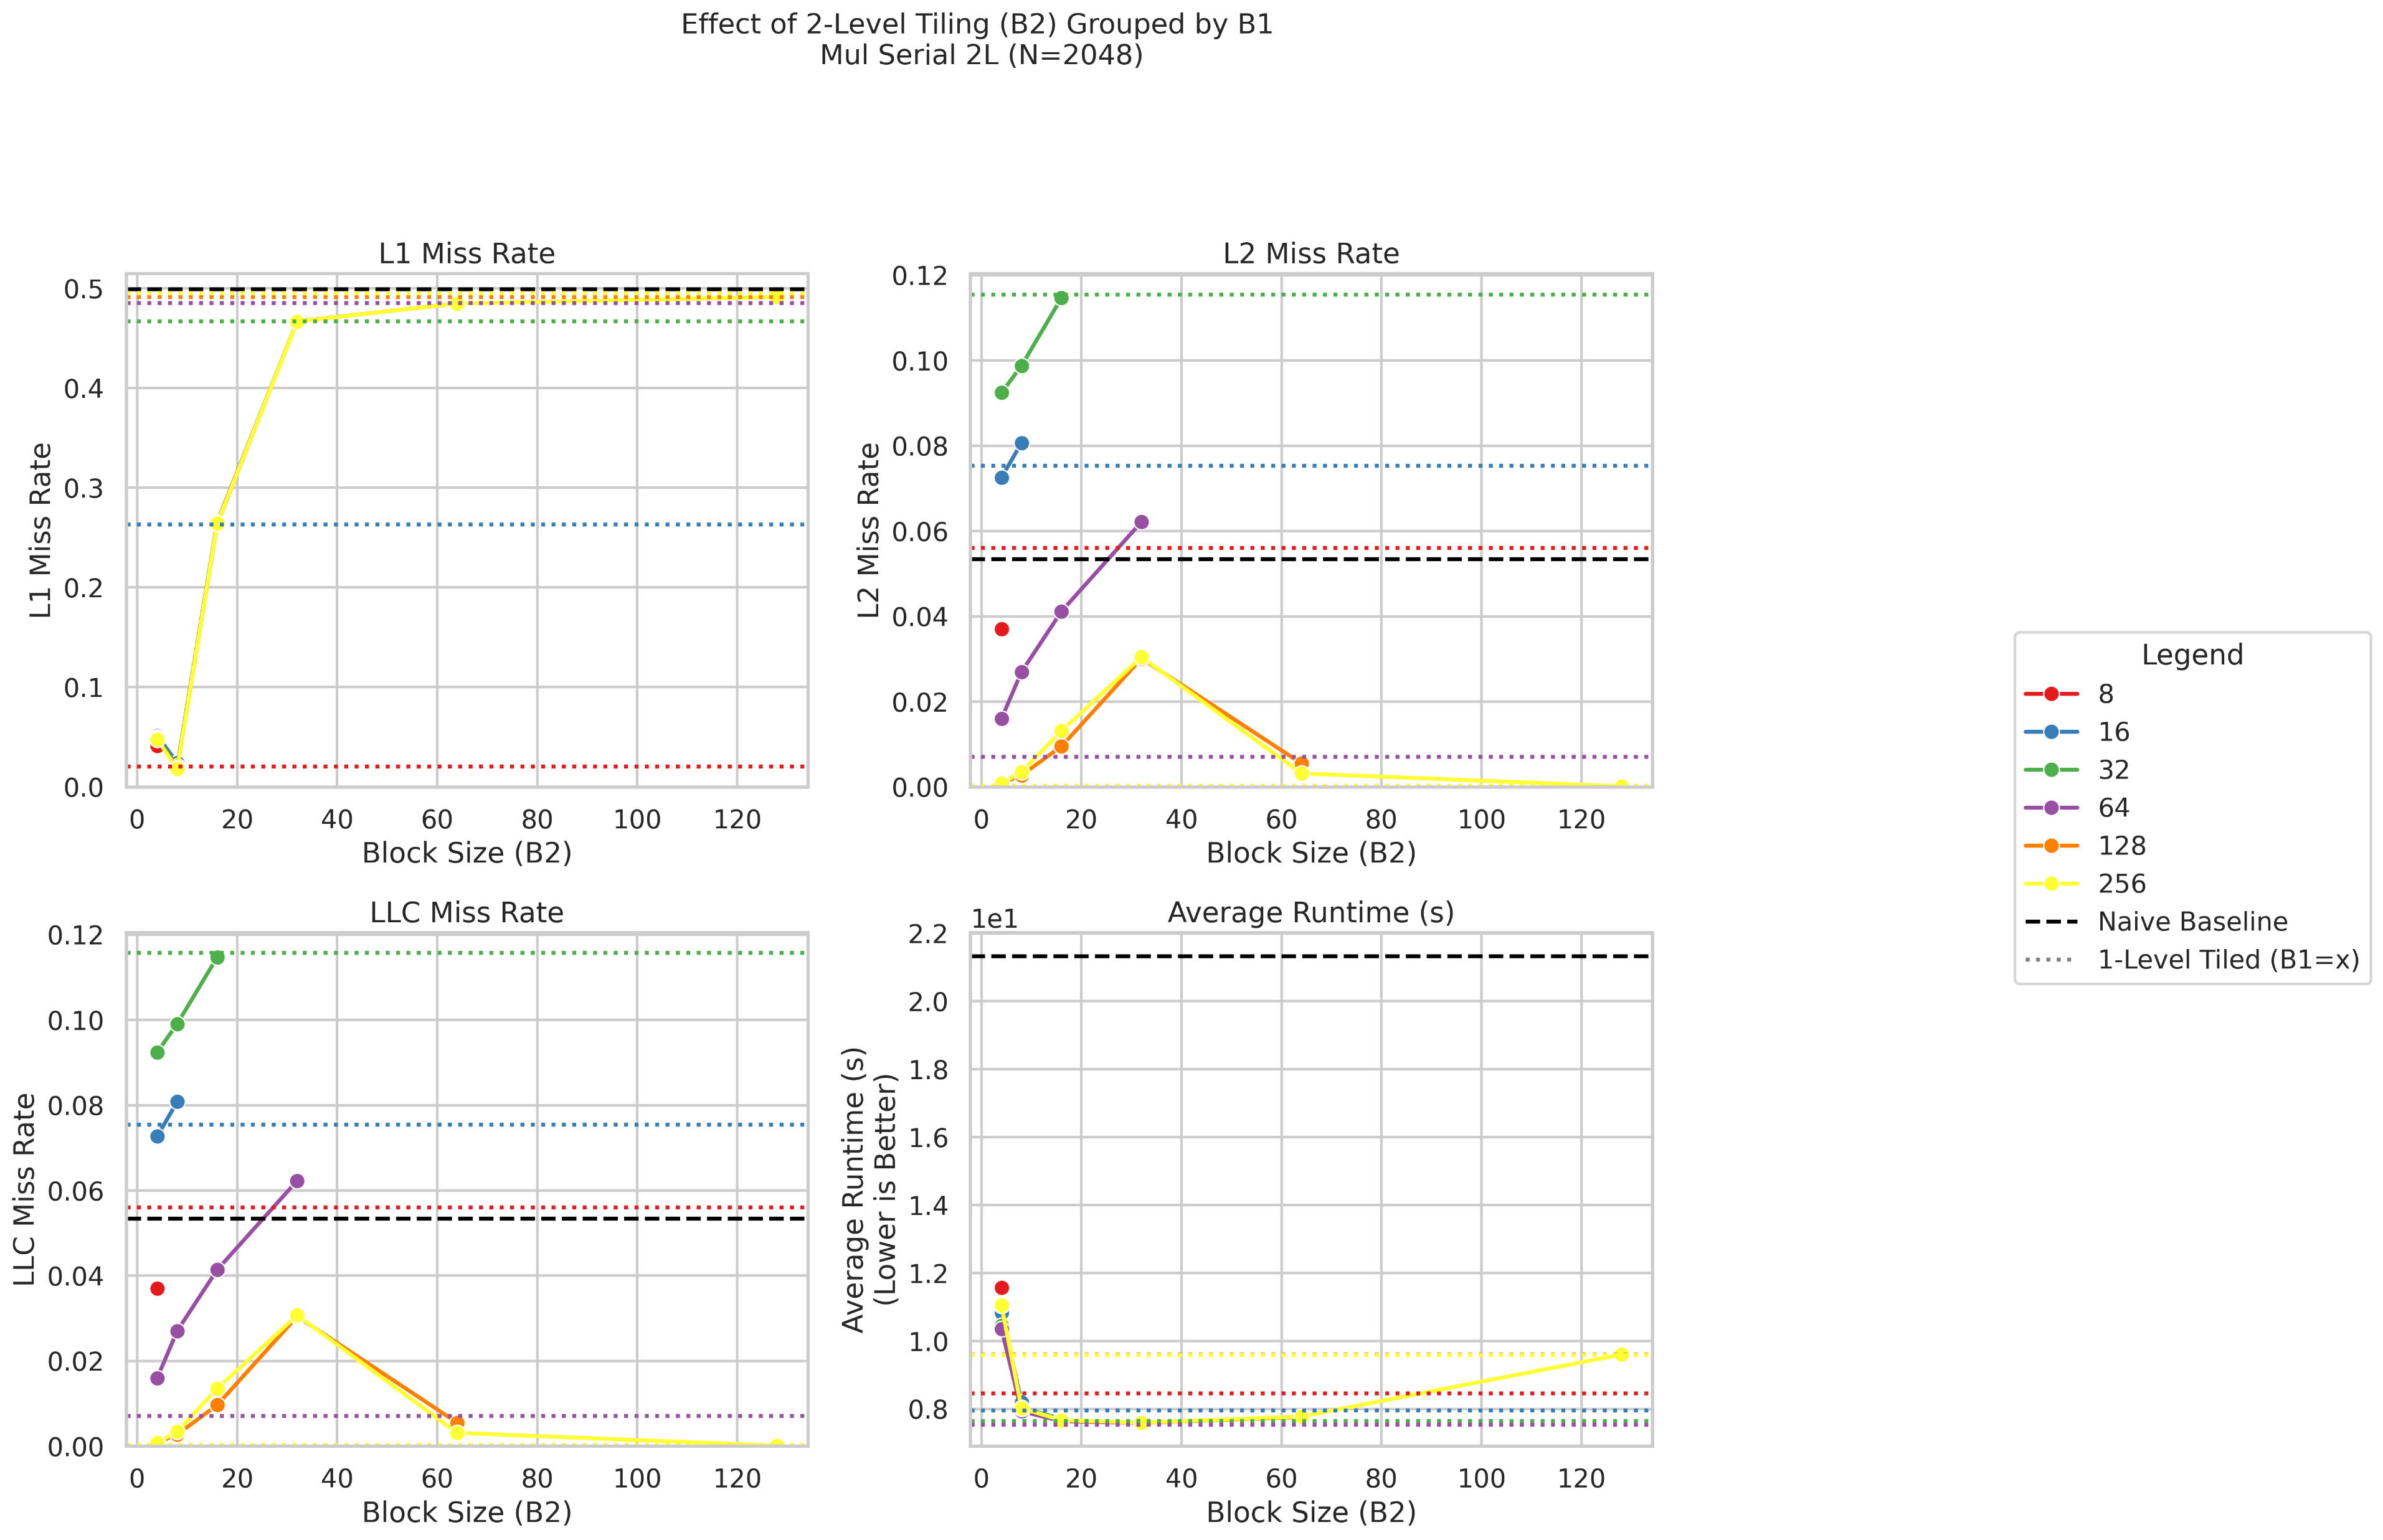
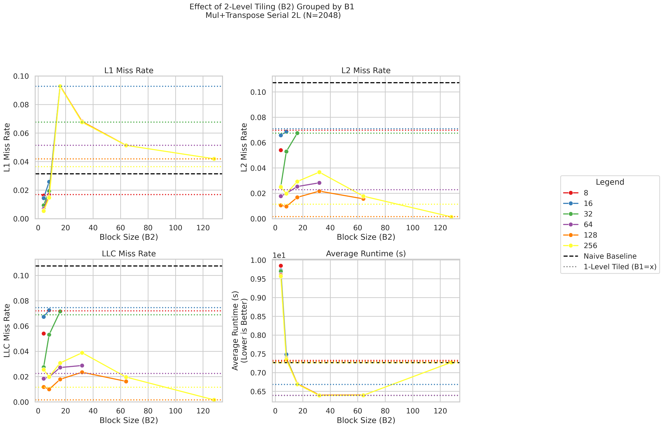
Perf evaluation

Slide 12
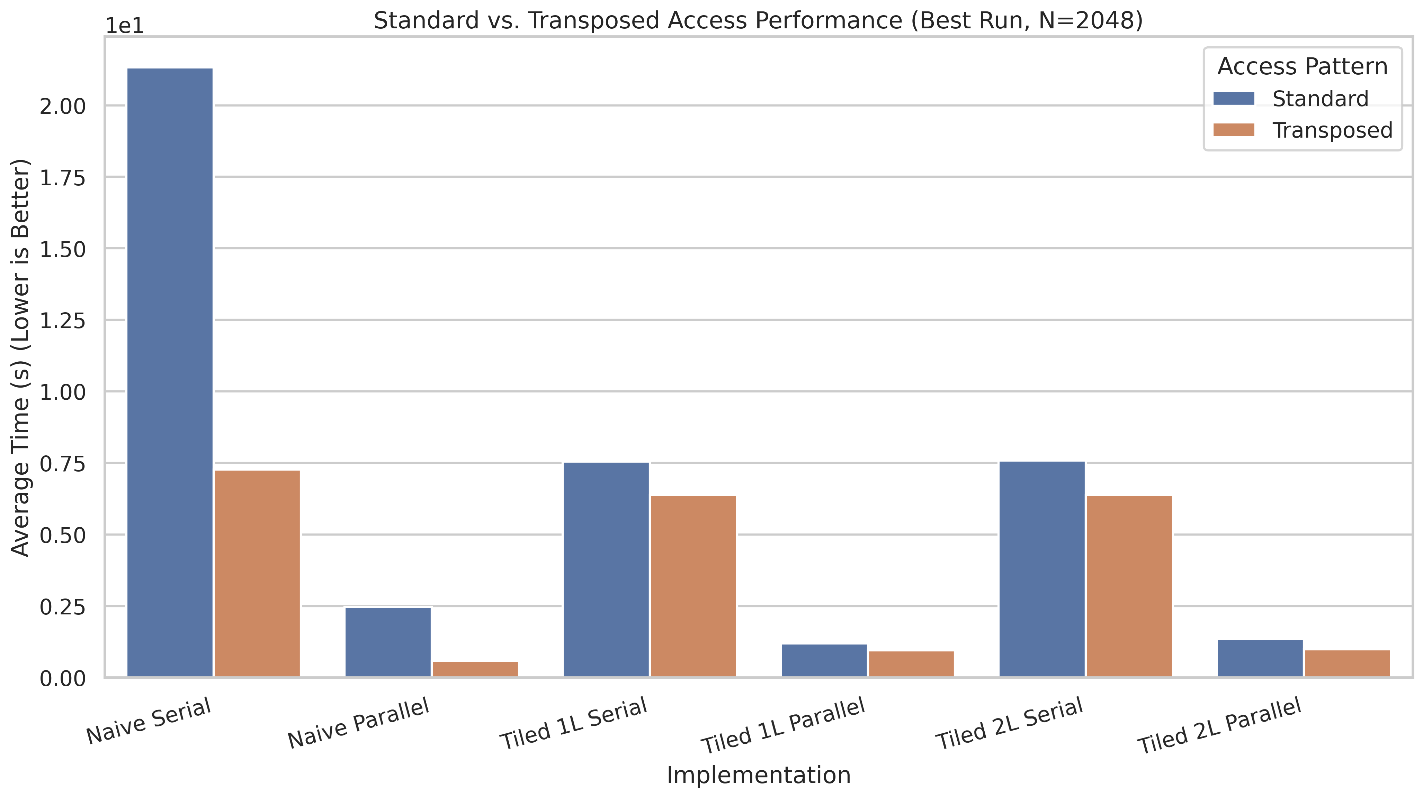
Perf evaluation

Slide 13
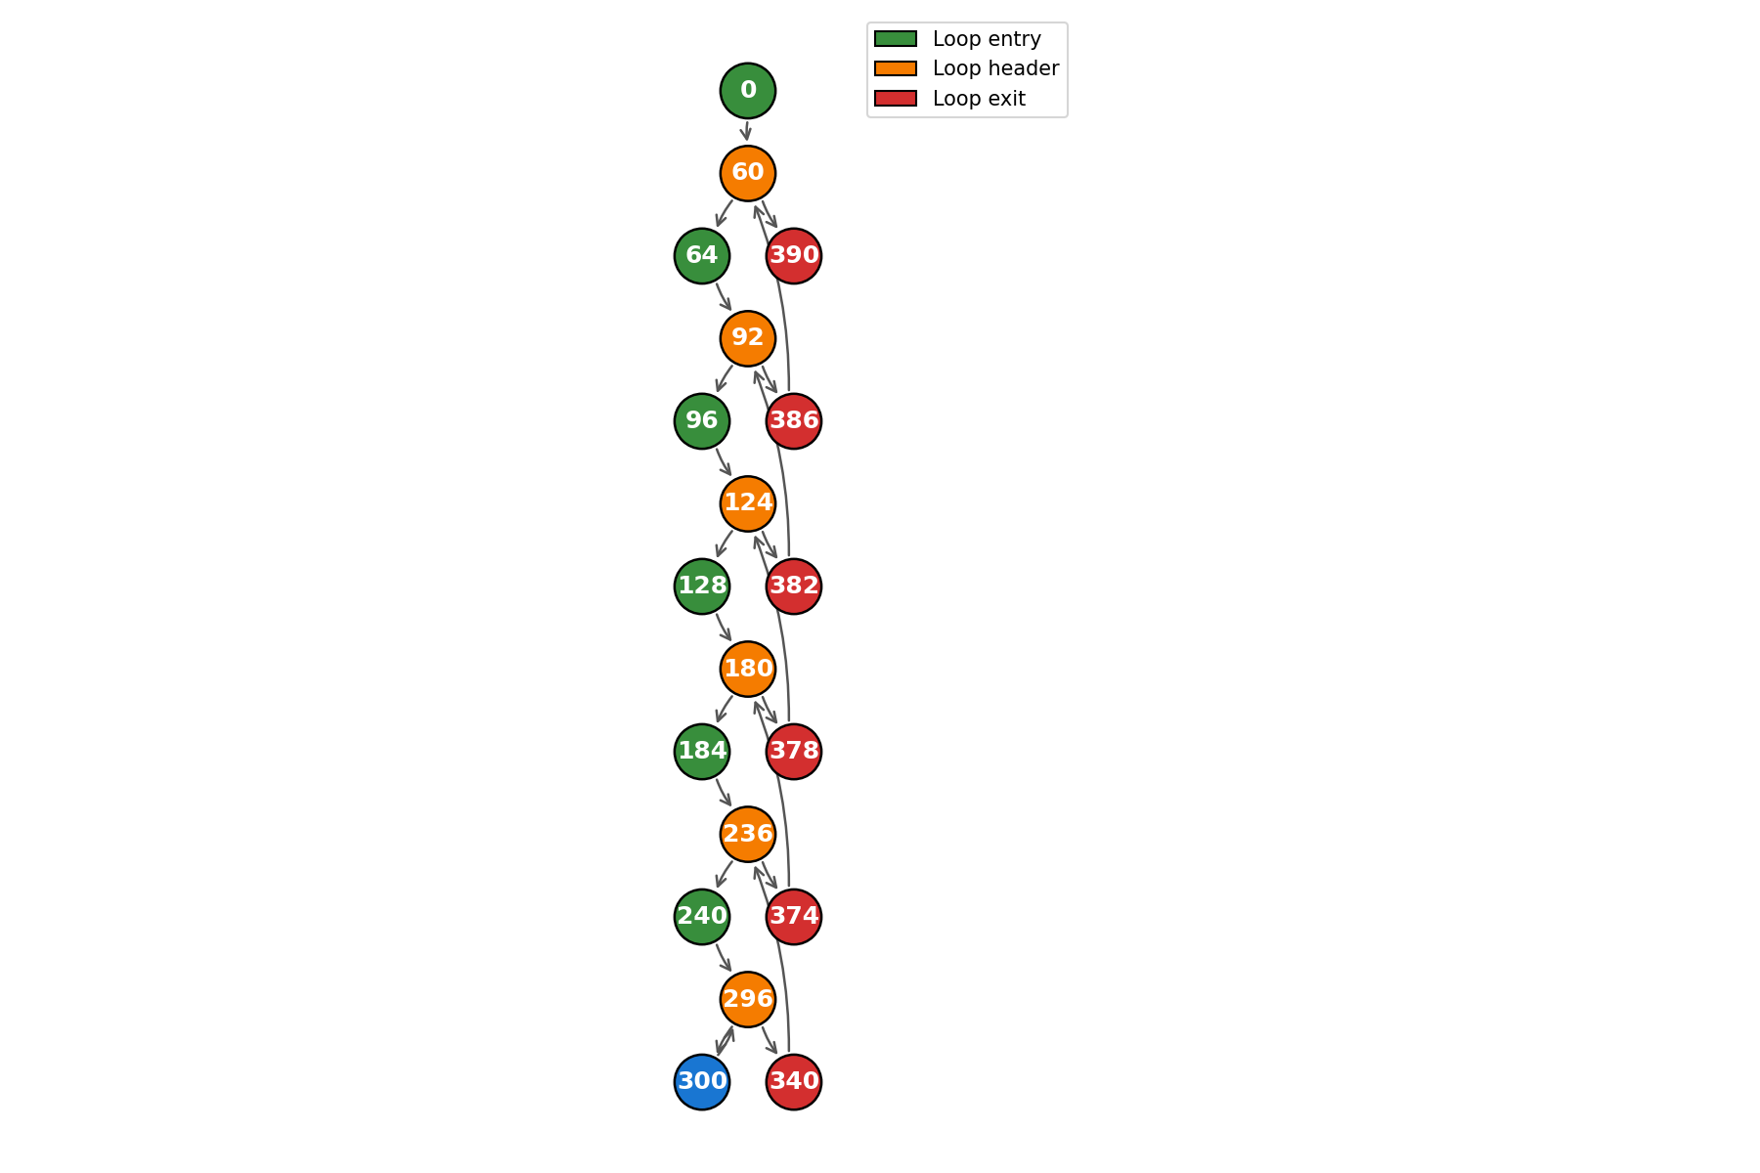
NUMBA Optimization for 1 level blocking
CFG loops:
{60: Loop(entries={0}, exits={390}, header=60, body={128, 96, 386, 64, 296, 236, 300, 60, 92, 240, 180, 340, 374, 184, 378, 124, 382}),
92: Loop(entries={64}, exits={386}, header=92, body={128, 96, 296, 236, 300, 92, 240, 180, 340, 374, 184, 378, 124, 382}),
124: Loop(entries={96}, exits={382}, header=124, body={128, 296, 236, 300, 240, 180, 340, 374, 184, 378, 124}),
180: Loop(entries={128}, exits={378}, header=180, body={296, 236, 300, 240, 180, 340, 374, 184}),
236: Loop(entries={184}, exits={374}, header=236, body={296, 236, 300, 240, 340}),
296: Loop(entries={240}, exits={340}, header=296, body={296, 300})}
Environment variables — Numba 0+untagged.663.ge6a4027.dirty documentation

Slide 14
3. Parallelism
Multicores

Slide 15
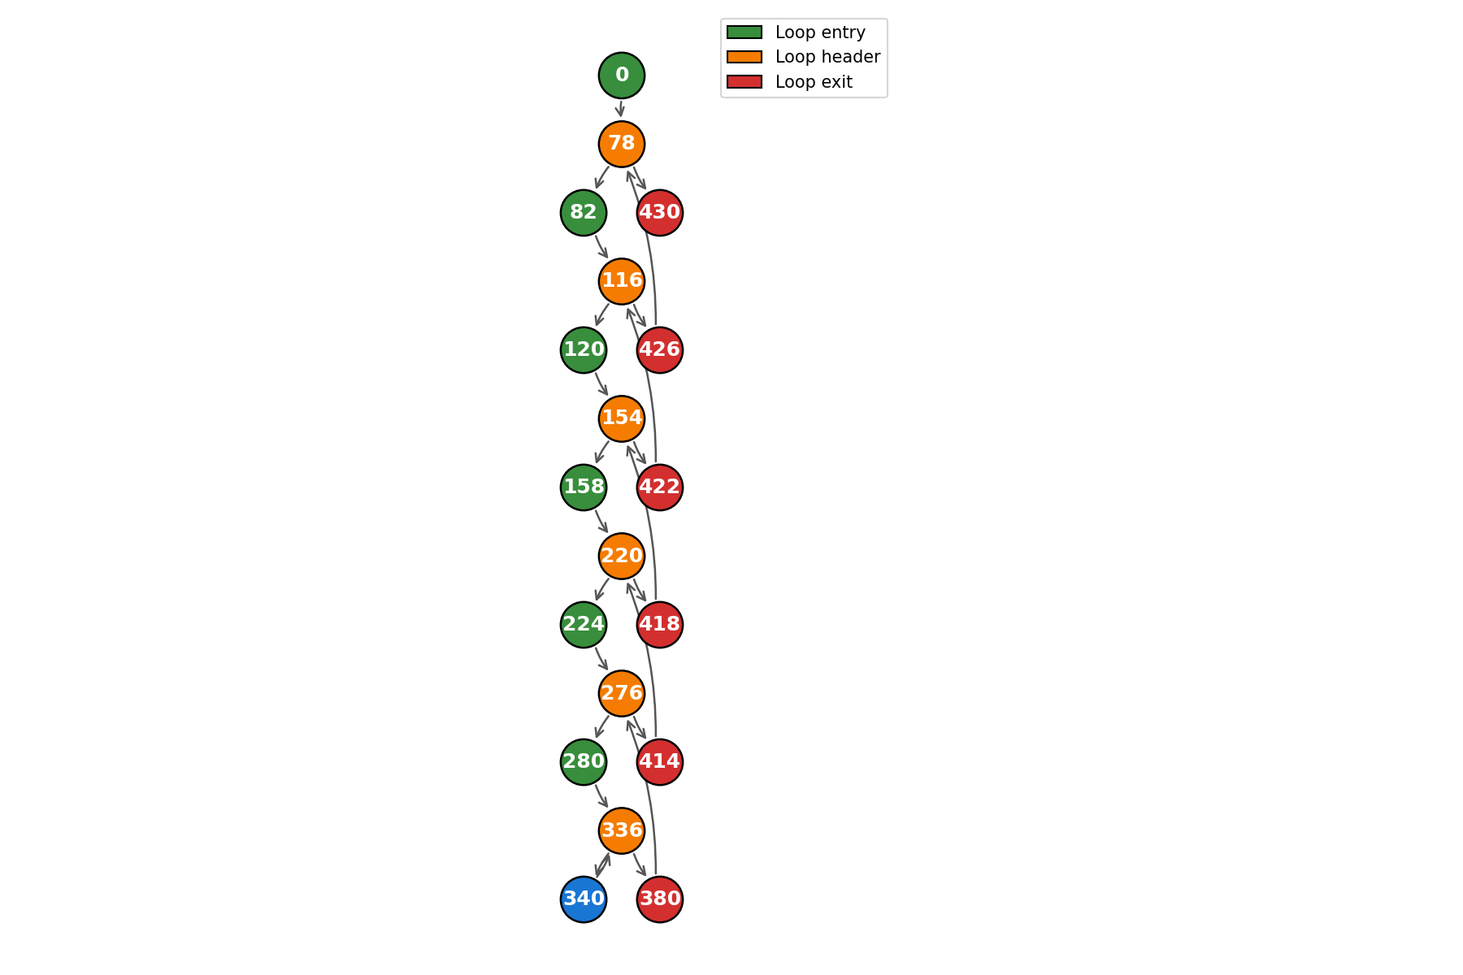
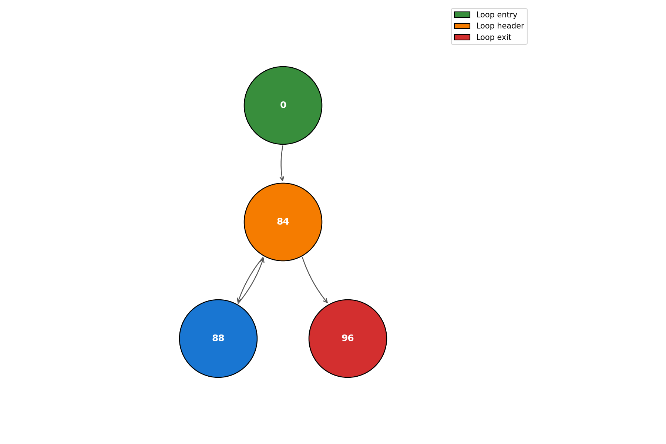
3.1 NUMBA Parallelism
@jit(nopython=True, parallel=True)
def numba_parallel_tiled_mul(A, B, C, B1):
N = A.shape[0]
num_tiles = (N + B1 - 1) // B1
for tile_idx_ii in prange(num_tiles):
ii = tile_idx_ii * B1
for tile_idx_jj in range(num_tiles):
jj = tile_idx_jj * B1
for tile_idx_kk in range(num_tiles):
kk = tile_idx_kk * B1
for i in range(ii, min(ii + B1, N)):
for j in range(jj, min(jj + B1, N)):
tmp = 0.0
for k in range(kk, min(kk + B1, N)):
tmp += A[i, k] * B[k, j]
C[i, j] += tmp
return C

Slide 16
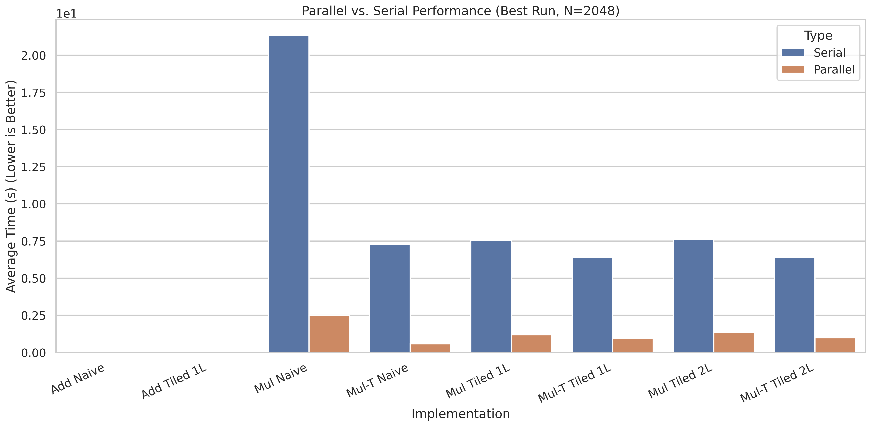
Perf evaluation

Slide 17
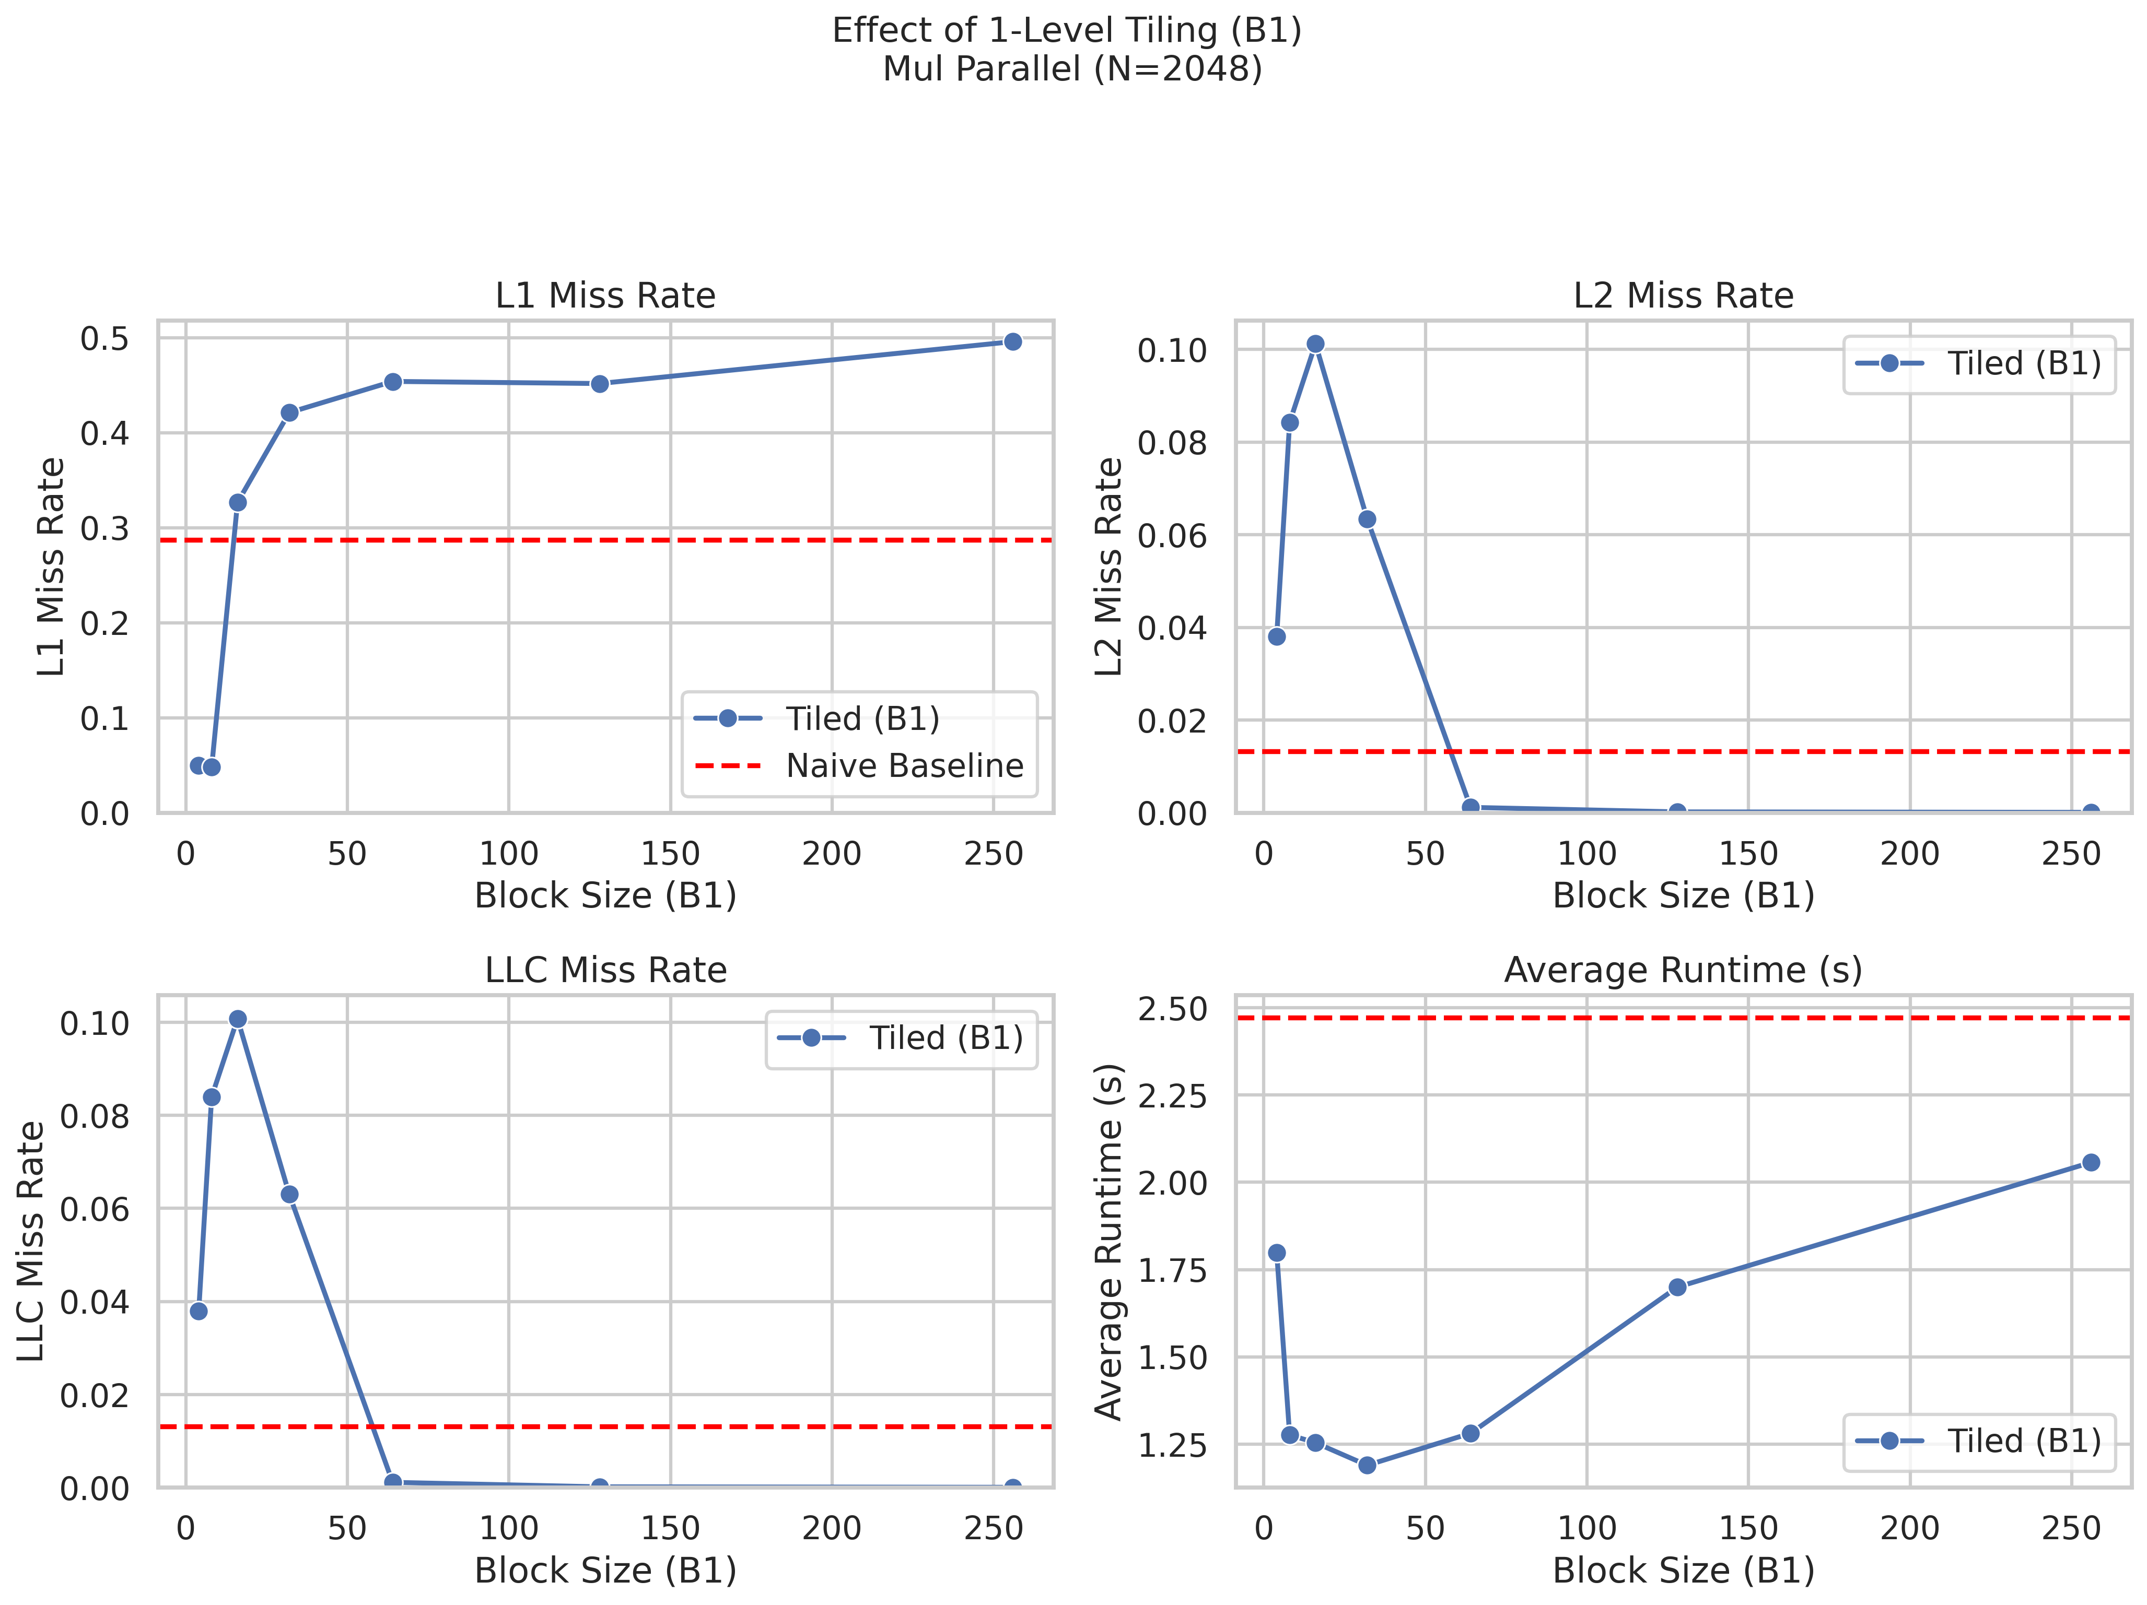
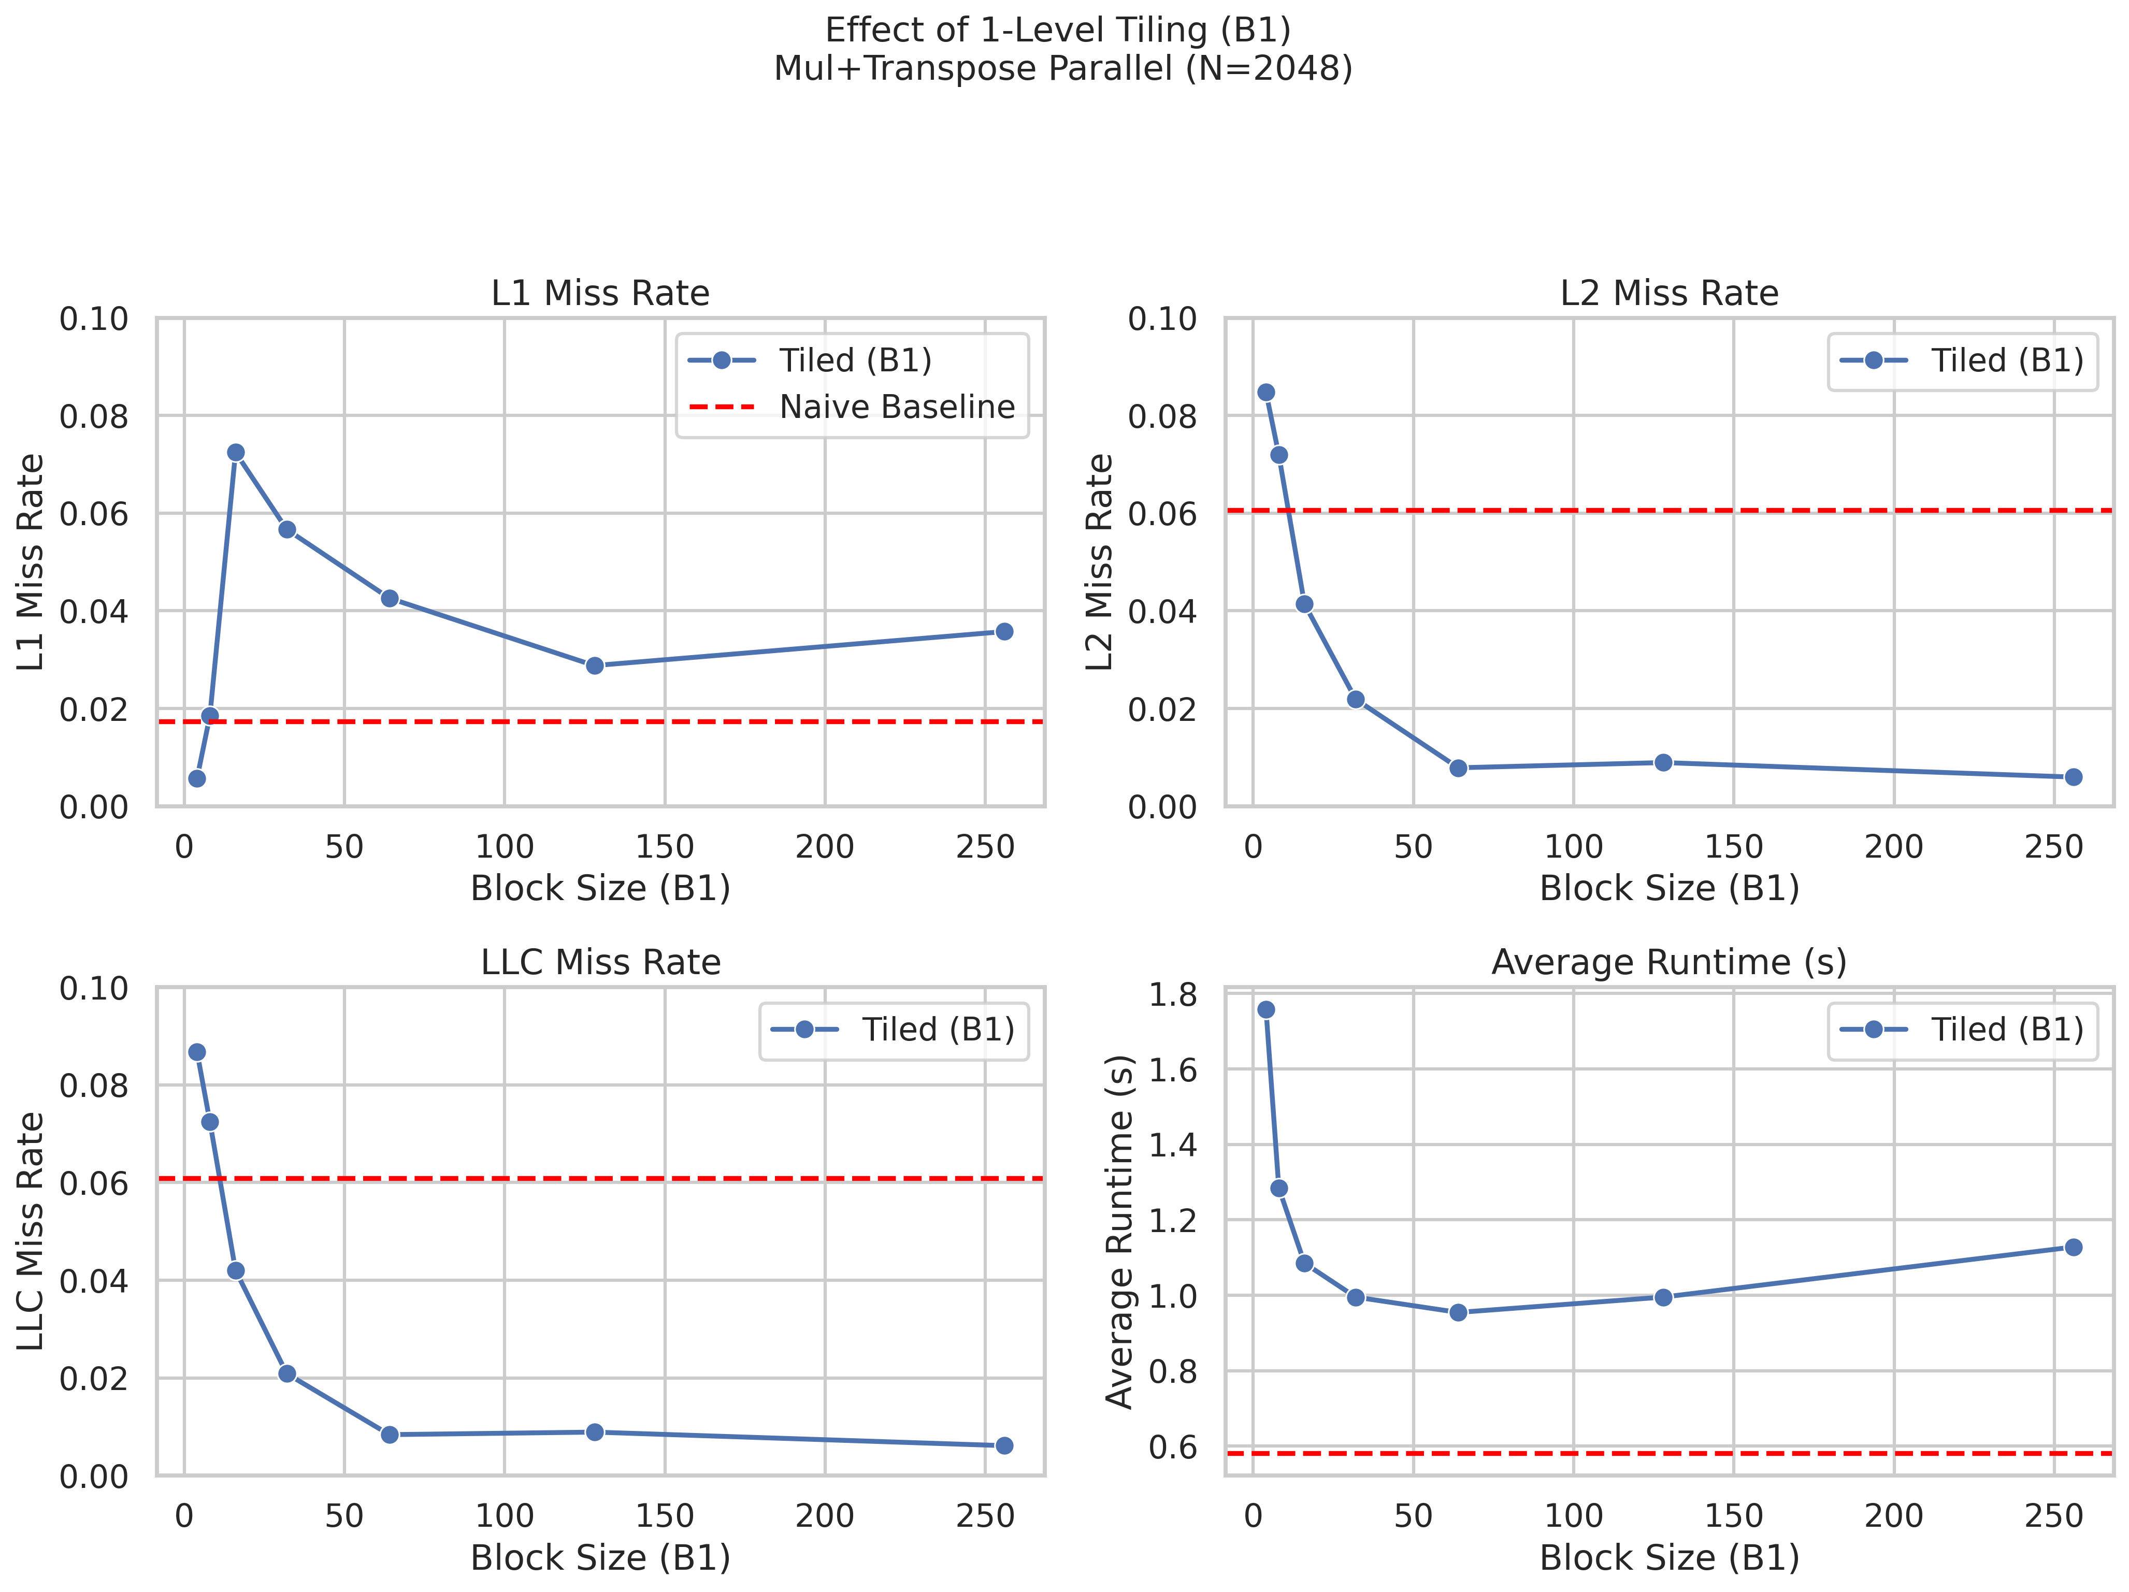
Perf evaluation

Slide 18
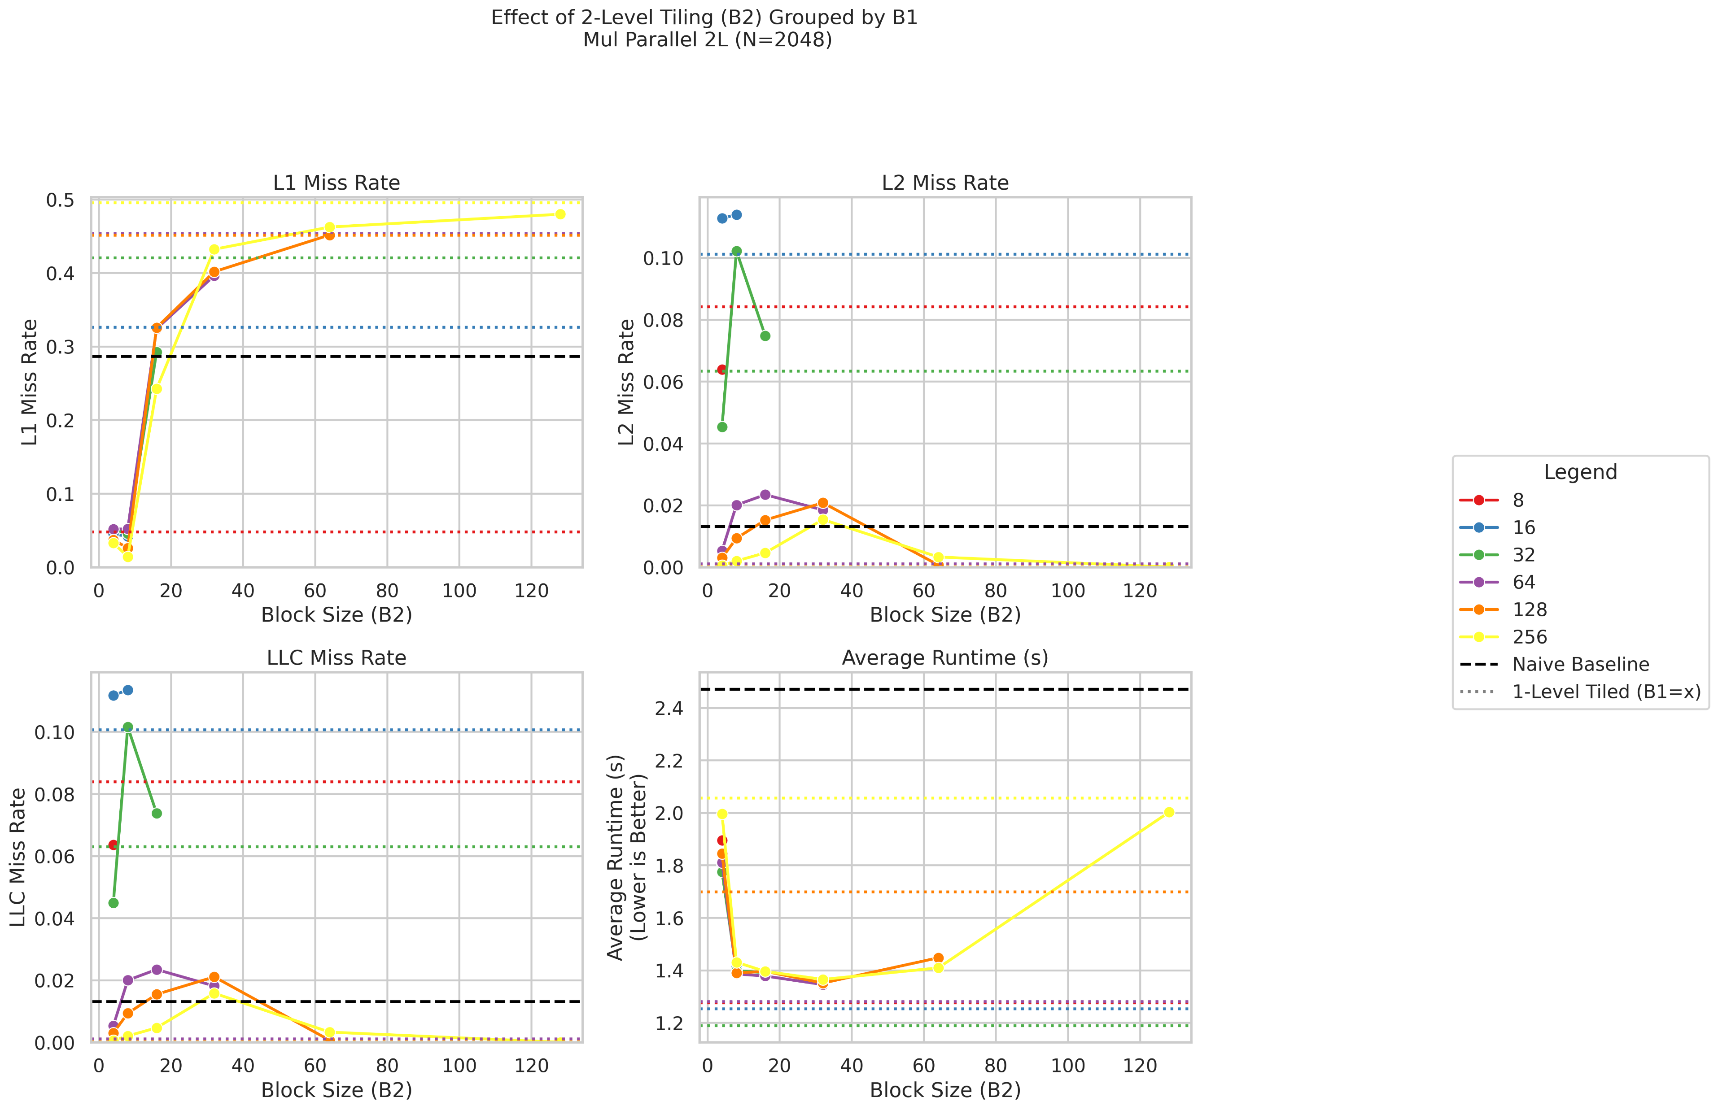
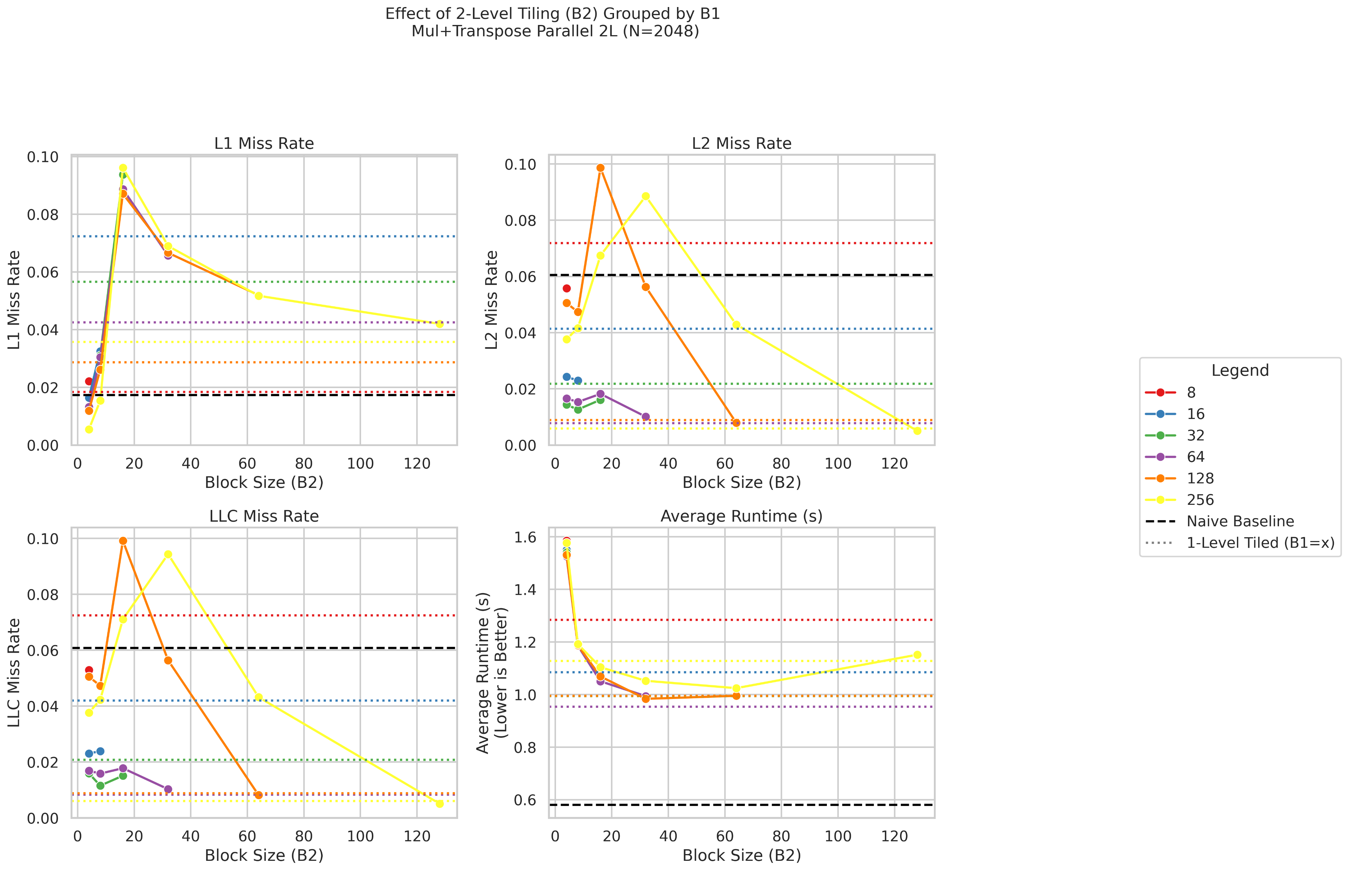
Perf evaluation

Slide 19
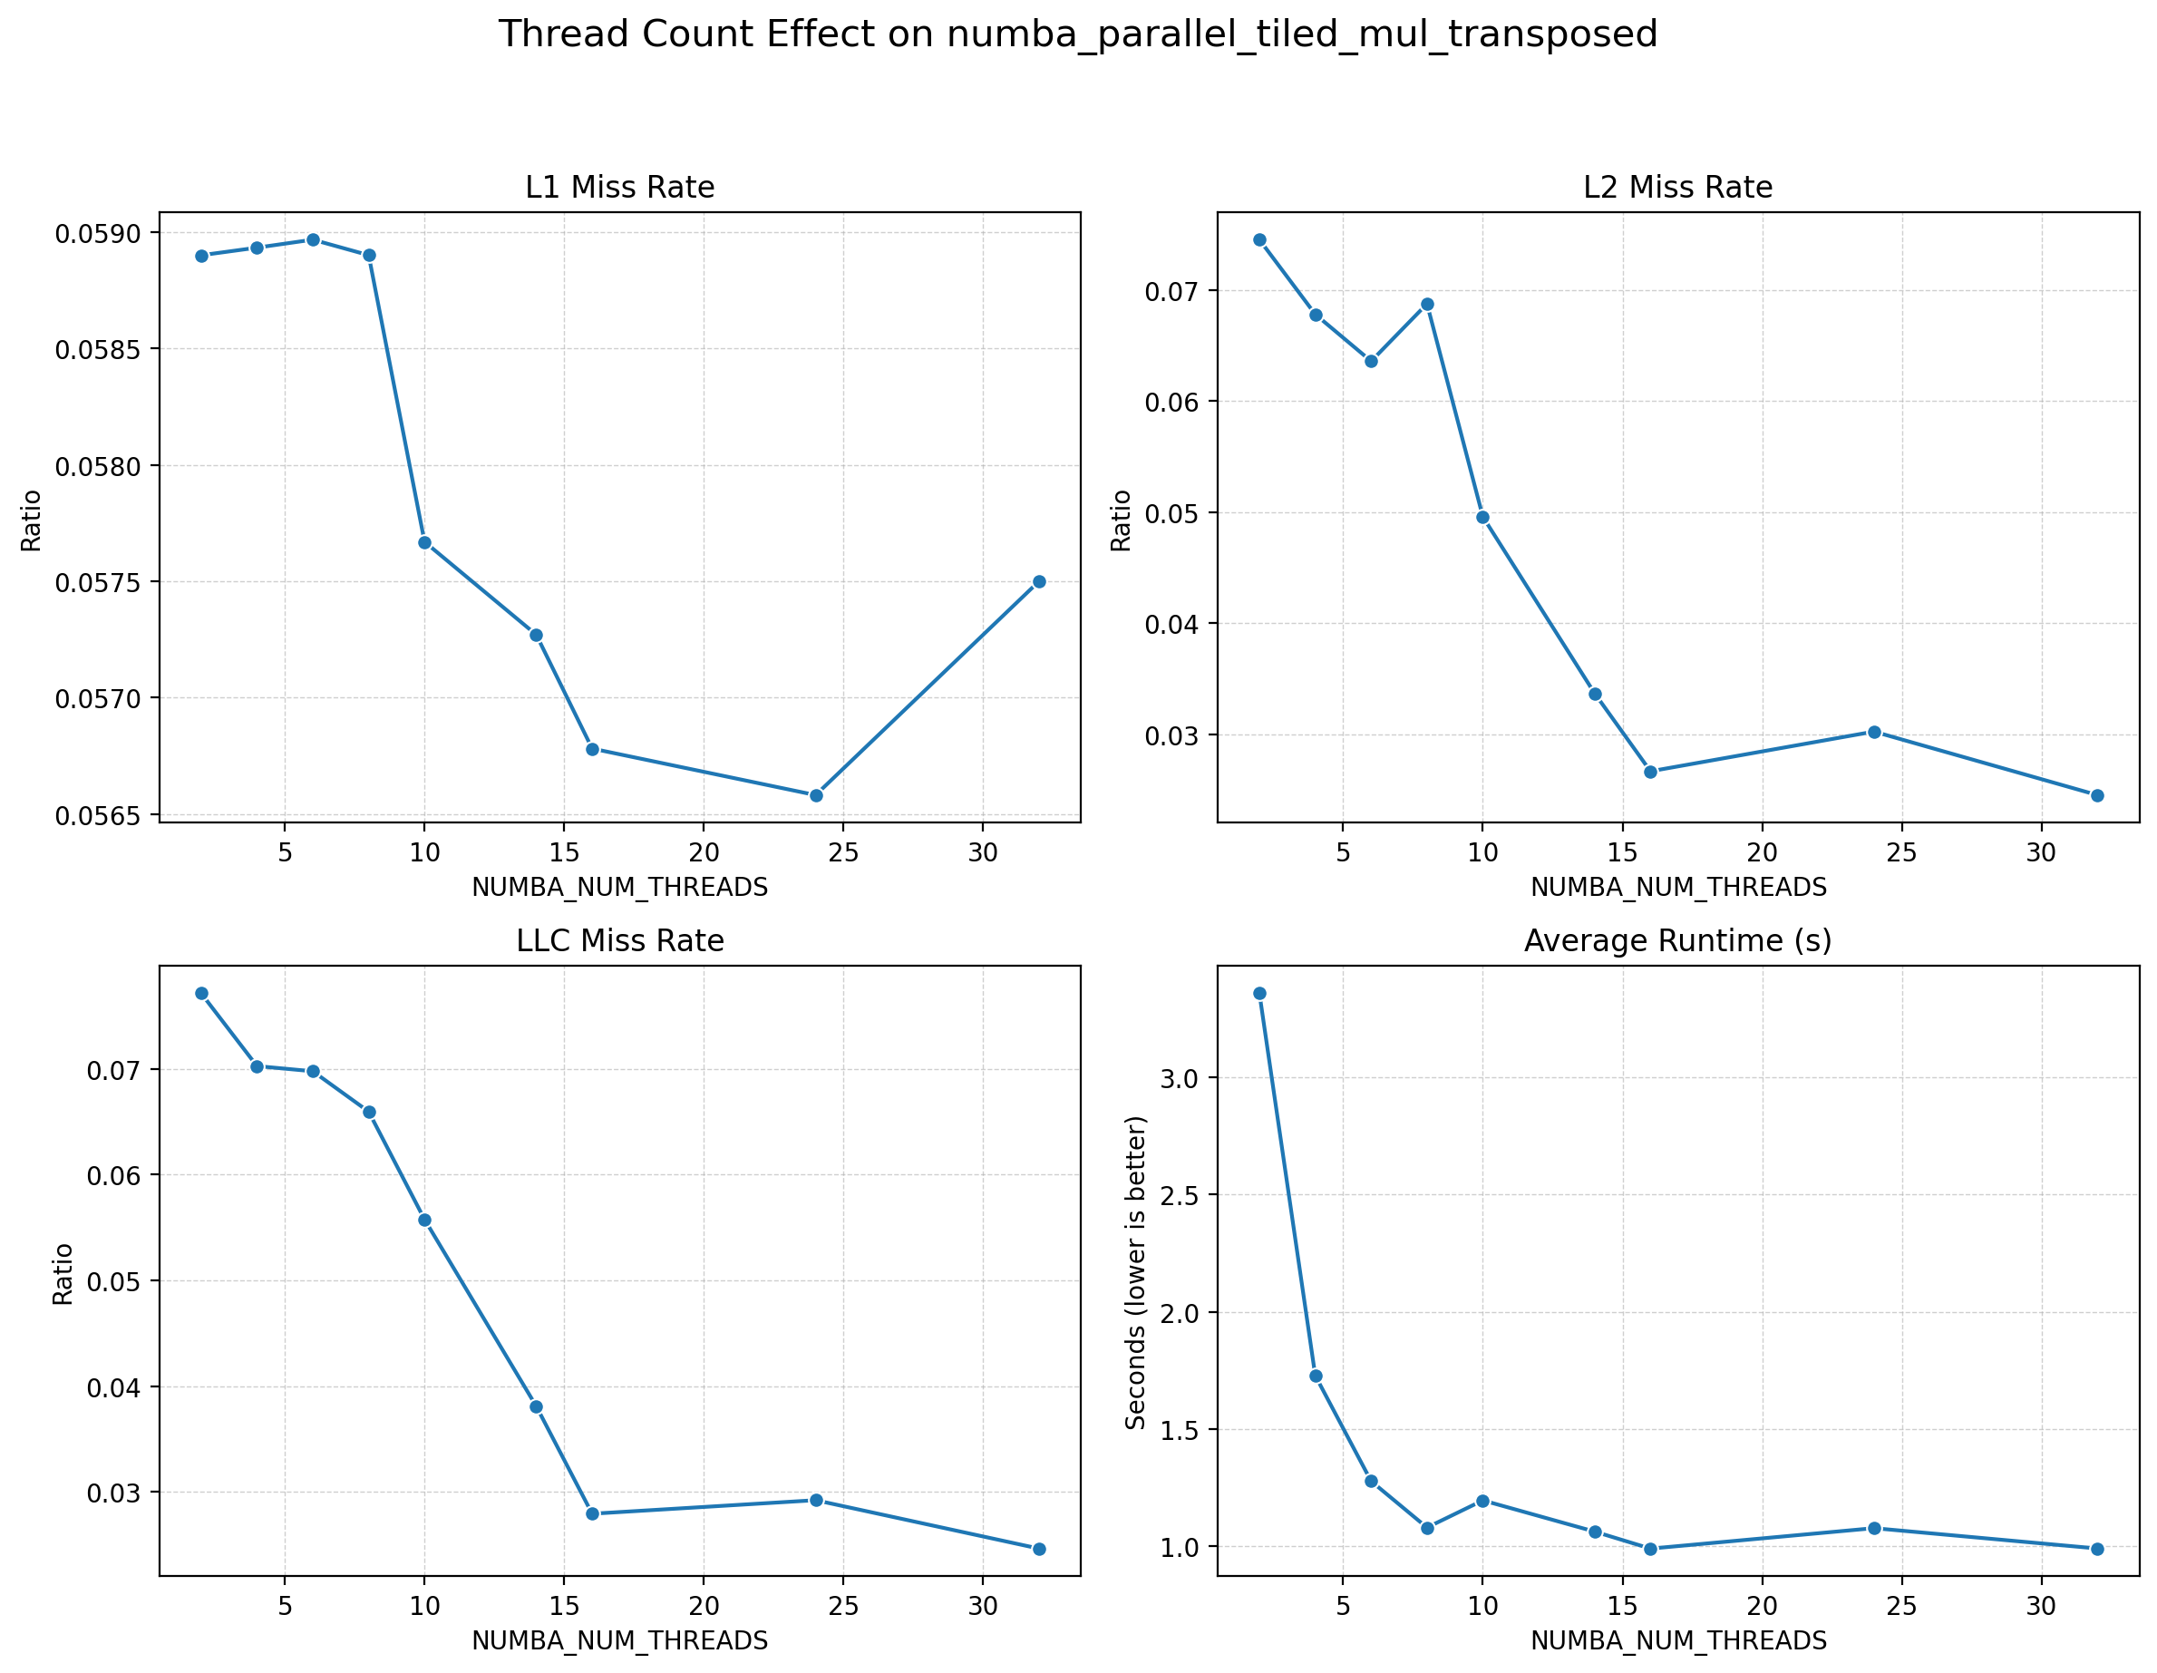
Threading - NUMBA_NUM_THREADS

Slide 20
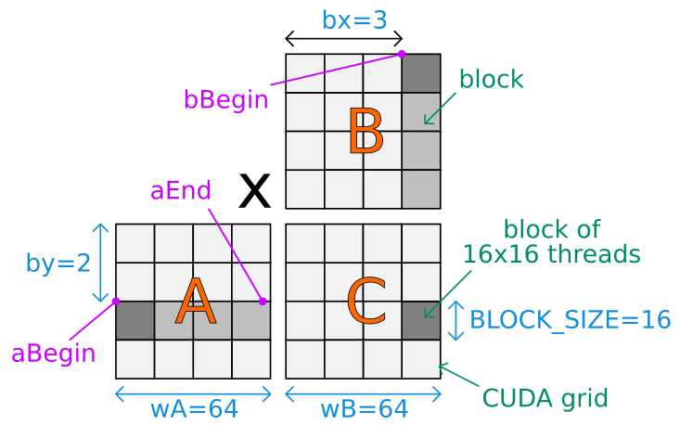
3.2 Parallelism - GPU
GPU is naturally blocking
int bx = blockIdx.x;
int by = blockIdx.y;
int tx = threadIdx.x;
int ty = threadIdx.y;
int aBegin = wA * BLOCK_SIZE * by;
int aEnd = aBegin + wA - 1;
int aStep = BLOCK_SIZE;
int bBegin = BLOCK_SIZE * bx;
int bStep = BLOCK_SIZE * wB;
float Csub = 0;
for (int a = aBegin, b = bBegin; a <= aEnd; a += aStep, b += bStep) {
__shared__ float As[BLOCK_SIZE][BLOCK_SIZE];
__shared__ float Bs[BLOCK_SIZE][BLOCK_SIZE];
As[ty][tx] = A[a + wA * ty + tx];
Bs[ty][tx] = B[b + wB * ty + tx];
for (int k = 0; k < BLOCK_SIZE; ++k) {
Csub += As[ty][k] * Bs[k][tx];
}
}
int c = wB * BLOCK_SIZE * by + BLOCK_SIZE * bx;
C[c + wB * ty + tx] = Csub;
cuda-samples/Samples/0_Introduction/matrixMul/matrixMul.cu at master · NVIDIA/cuda-samples
parallel processing - CUDA tiled matrix multiplication explanation - Stack Overflow

Slide 21
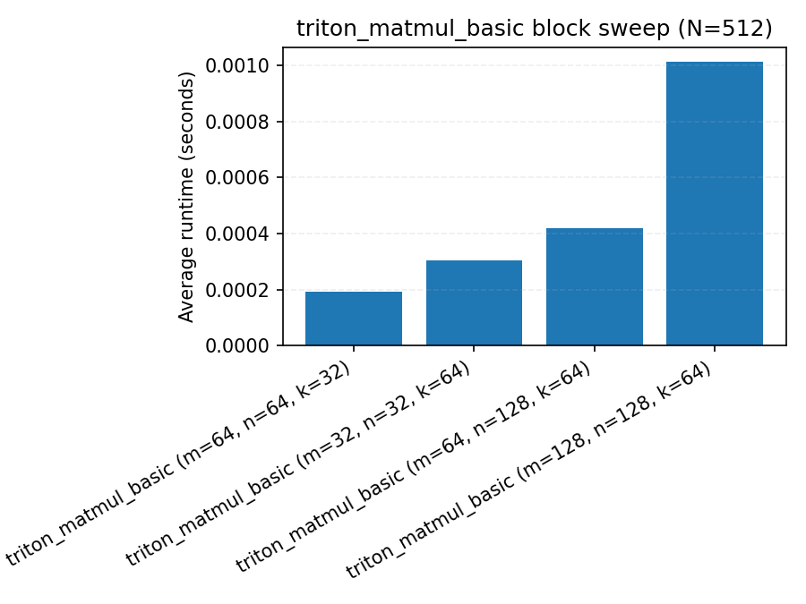

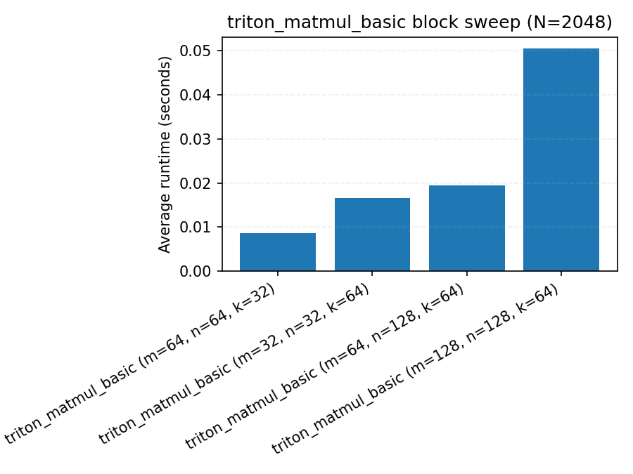

3.2 Triton Performance – GTX 1660

Slide 22
3.2 Triton Autotune
Warming up:
Runs with different config
Pick the best config
Later if x_size did not change:
Reuse the best config
Limitation
Slow down the warming up stages
Print autotune result
TRITON_PRINT_AUTOTUNING=1 python triton_demo.py
Config Variables:
num_warps – the number of warps to use for the kernel when compiled for GPUs. For example, if num_warps=8, then each kernel instance will be automatically parallelized to cooperatively execute using 8 * 32 = 256 threads.
num_stages – the number of stages that the compiler should use when software-pipelining loops. Mostly useful for matrix multiplication workloads on SM80+ GPUs.
num_ctas – number of blocks in a block cluster. SM90+ only.
maxnreg – maximum number of registers one thread can use. Corresponds to ptx .maxnreg directive. Not supported on all platforms.
pre_hook – a function that will be called before the kernel is called. Parameters of this function are args.
@triton.autotune(configs=[
triton.Config(kwargs={'BLOCK_SIZE': 128}, num_warps=4),
triton.Config(kwargs={'BLOCK_SIZE': 1024}, num_warps=8),
],
key=['x_size'] # the two above configs will be evaluated anytime
# the value of x_size changes
)
@triton.jit
def kernel(x_ptr, x_size, BLOCK_SIZE: tl.constexpr):
triton.autotune — Triton documentation

Slide 23
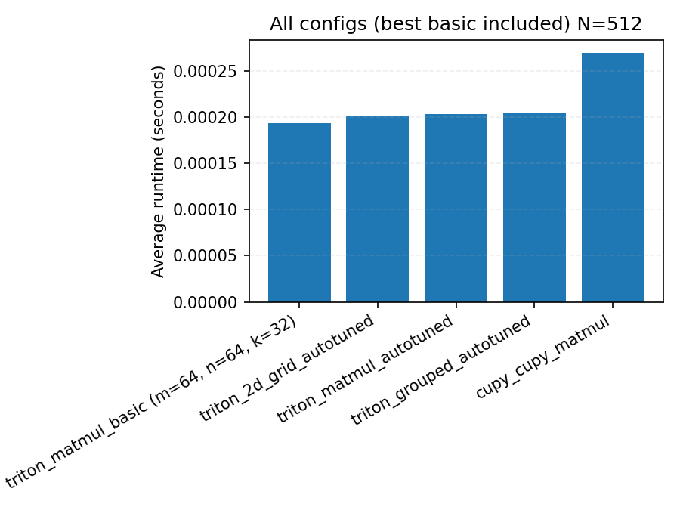
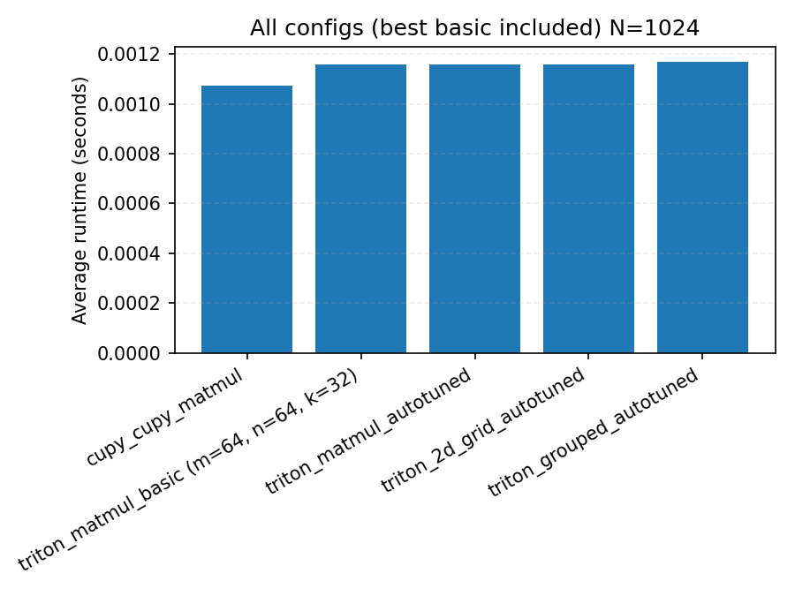
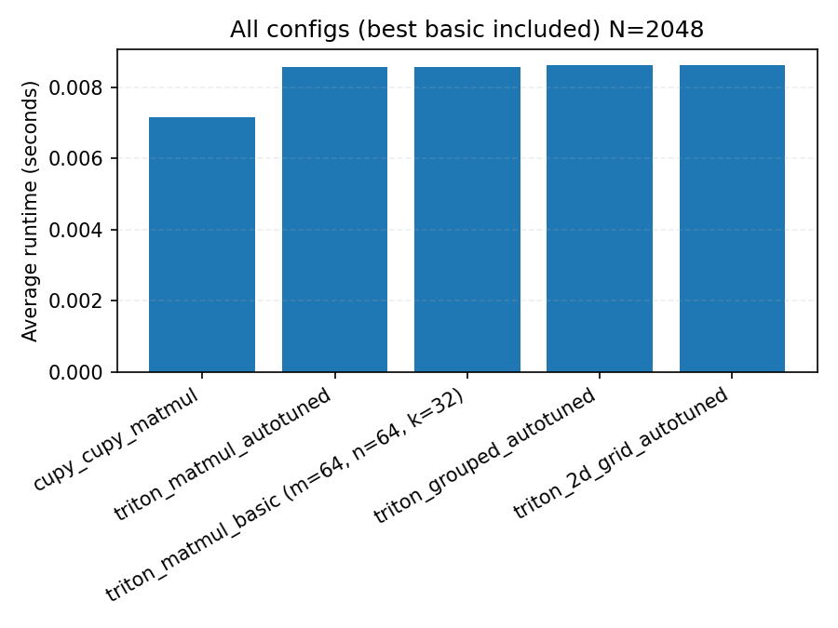
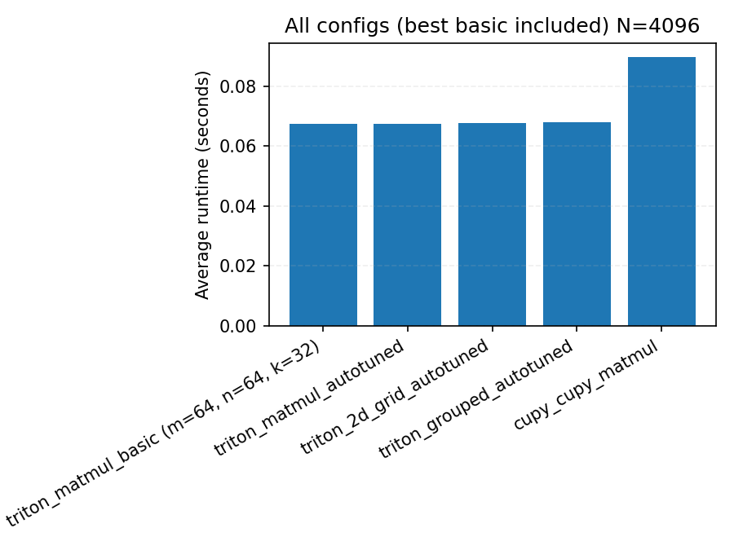
3.2 Triton Autotune Performance – GTX 1660

Slide 24
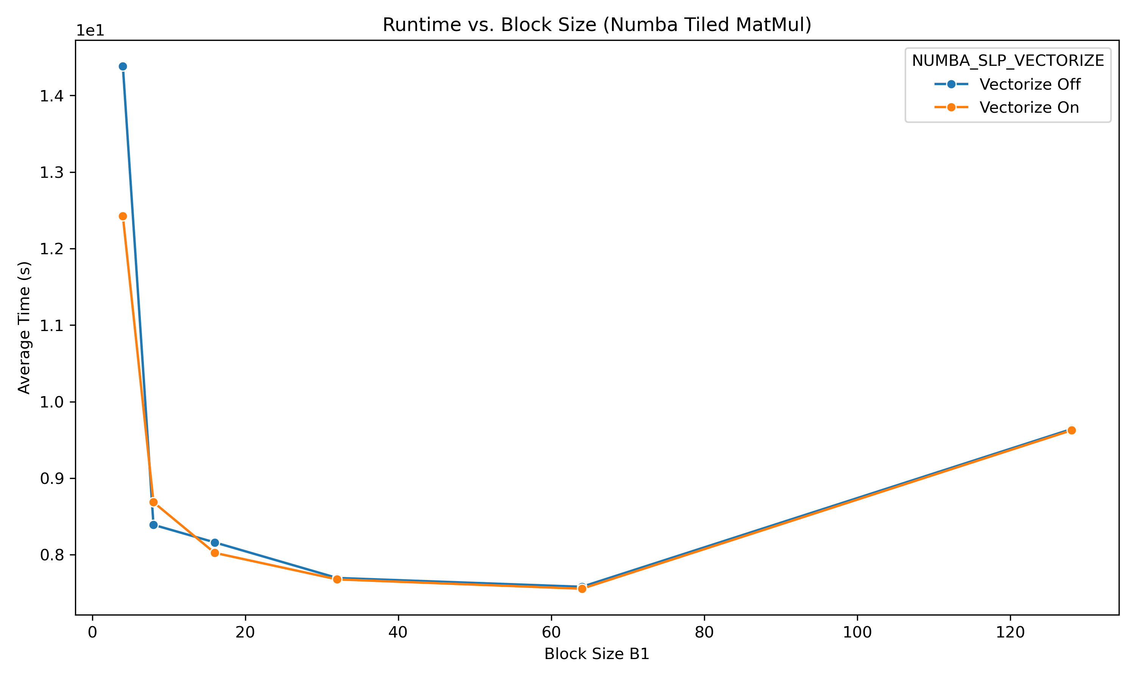
4. NUMBA Vectorization
NUMBA_LOOP_VECTORIZE (Default ON)
NUMBA_SLP_VECTORIZE (Default Off)
SLP: Super word level parallelism, aka SIMD

Slide 25
Thank you
Github Link: https://github.com/laiy24/matmul_numba_triton

